Slide 1

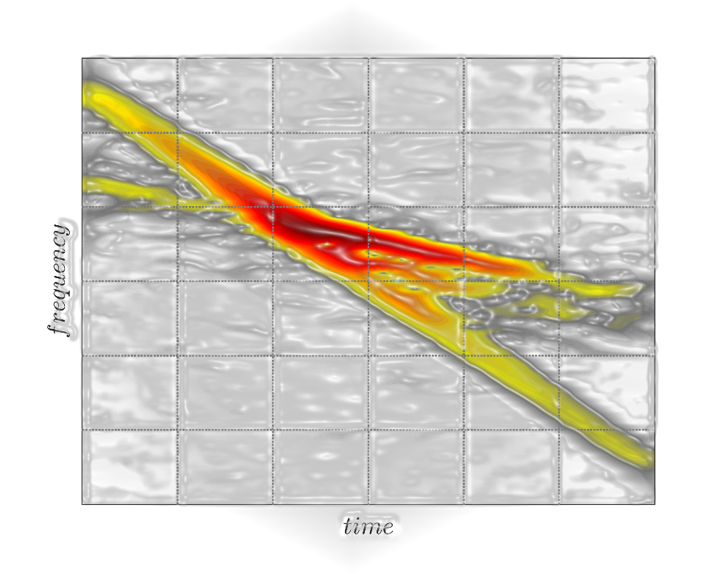



Identification of linear time-variant rotor components in resonance crossing Experimental validation
Davide Iaffaldano, Luigi Carassale
Dynamics & Monitoring Lab, University of Genova
Roberto Guida
Ansaldo Energia, Genova

Slide 2
Summary
1. Introduction. Modal identification of rotor components
2. Key features of resonance crossing. Linear time variant nature of system
3. Experimental set up.
4. Wavelet probing. Theorical background
5. Motivation. Analysis of LTV system needs something more
6. Proposed methods for LTV identification. It’s a matter of rotating
7. Results and conclusions.

Slide 3
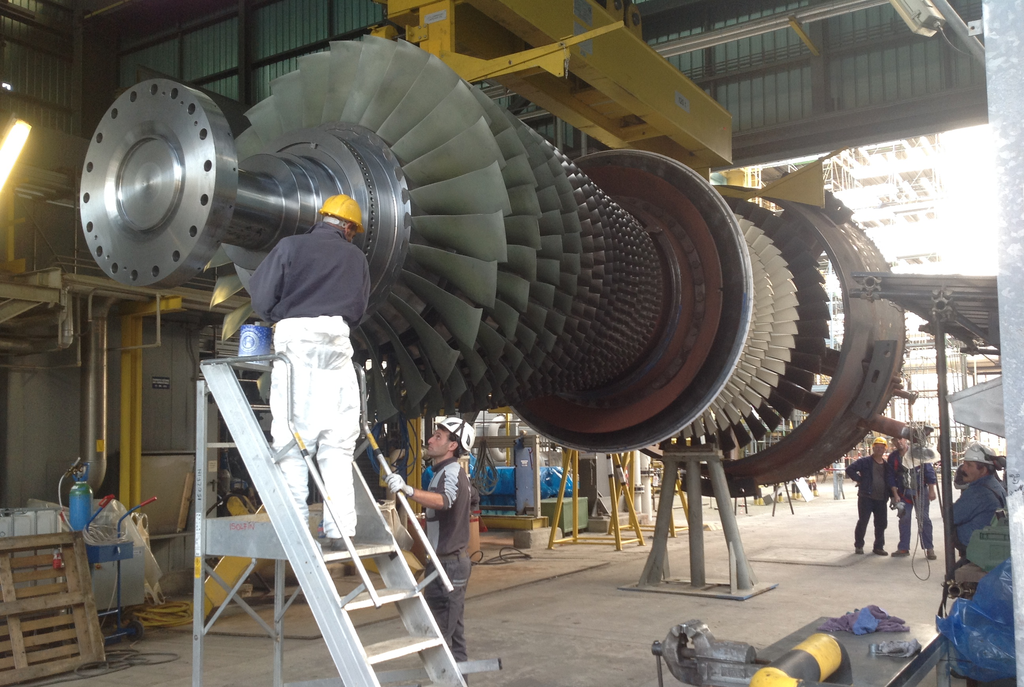
Courtesy of Ansaldo Energia

Slide 4
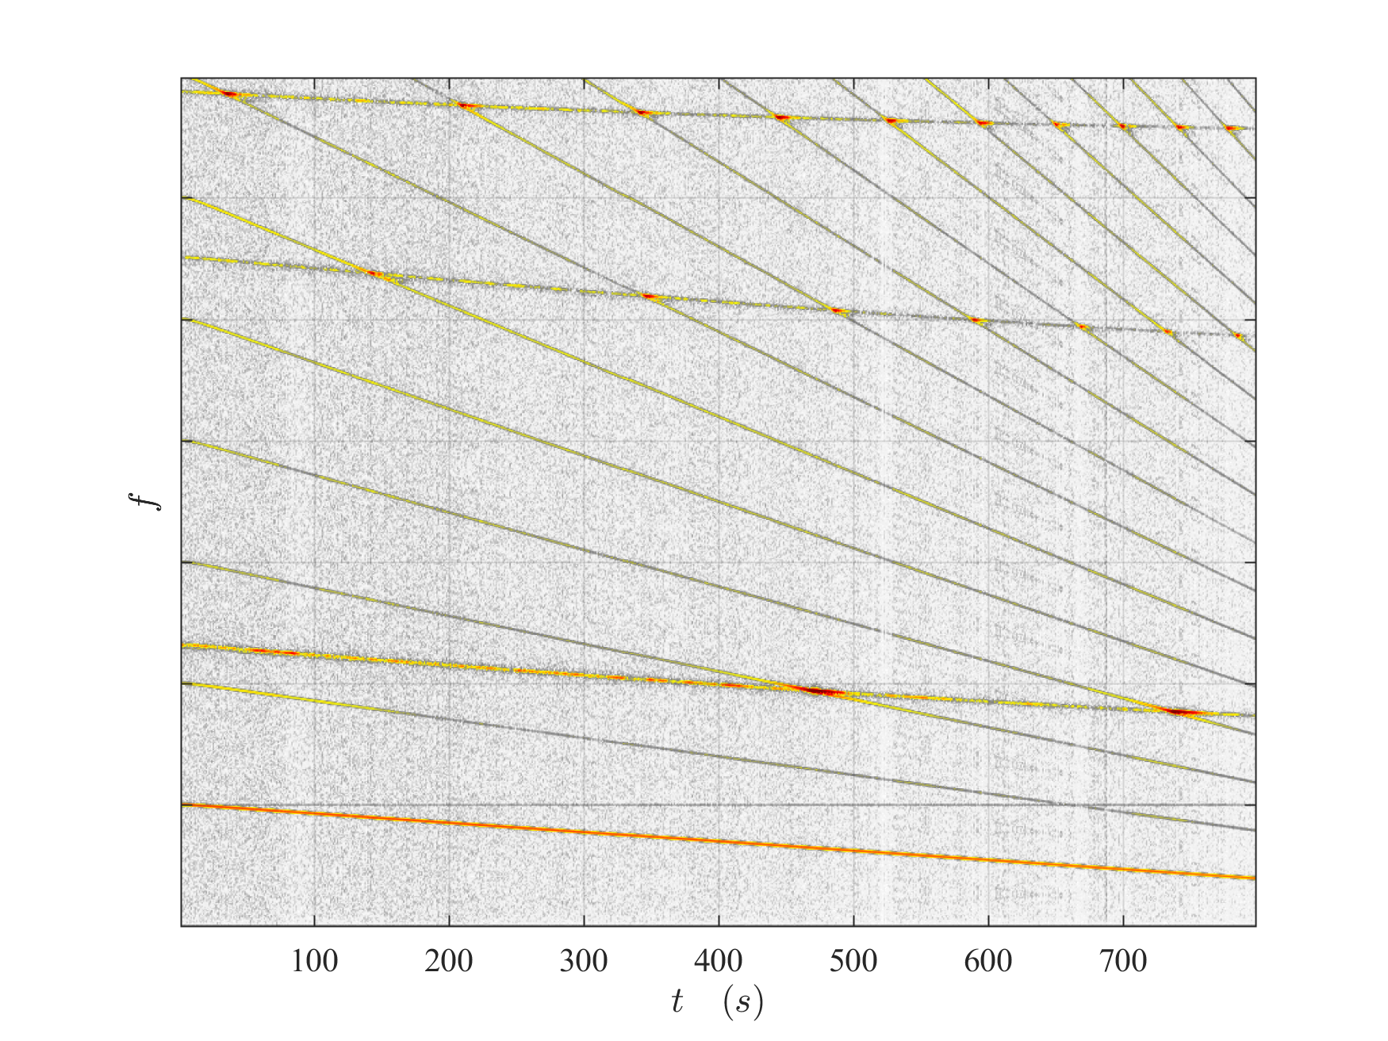
Resonance Crossing
Mode 3
Mode 2
Mode 1
4x
3x
2x
Rotor speed

Slide 5
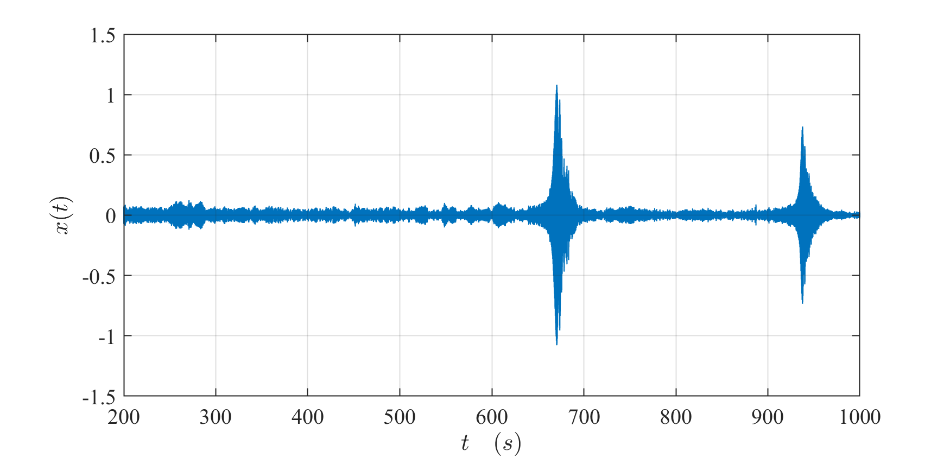

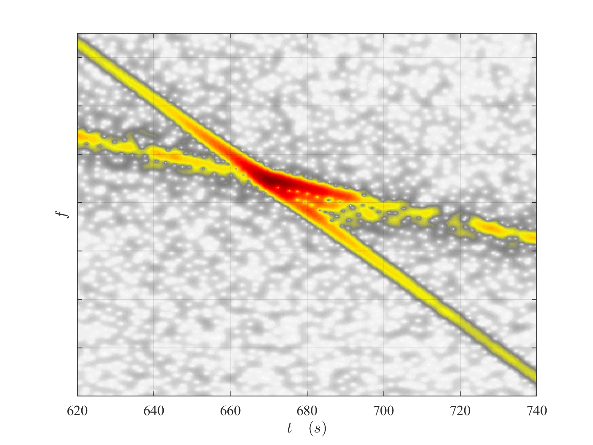
Resonance Crossing

Slide 6
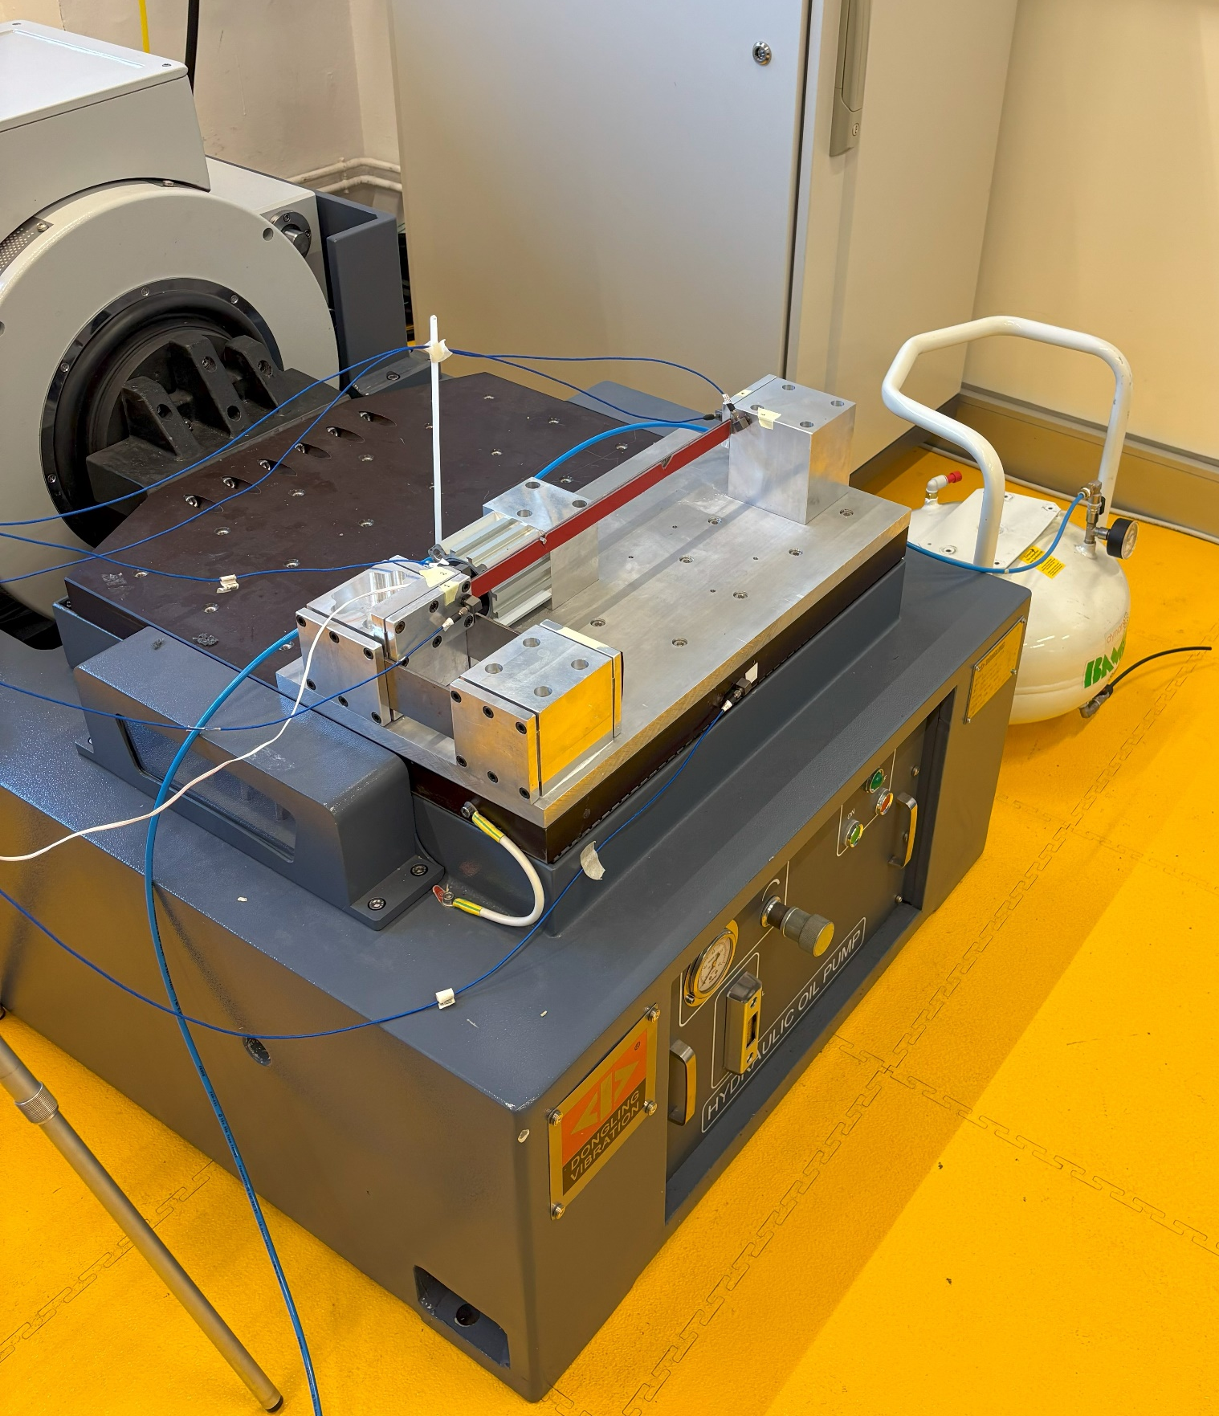
Experimental set up
Set up
Notes:
a thin still beam whose natural frequencies are modified by changing its axial load. One extremity of the beam is fixed to the frame, while the other end is fixed to an anchor block that only allows the axial component of the displacement. The axial load of the beam is controlled by a pneumatic cylinder. The pressure inside the pneumatic cylinder controlled by proportional regulator with analogic signal

Slide 7
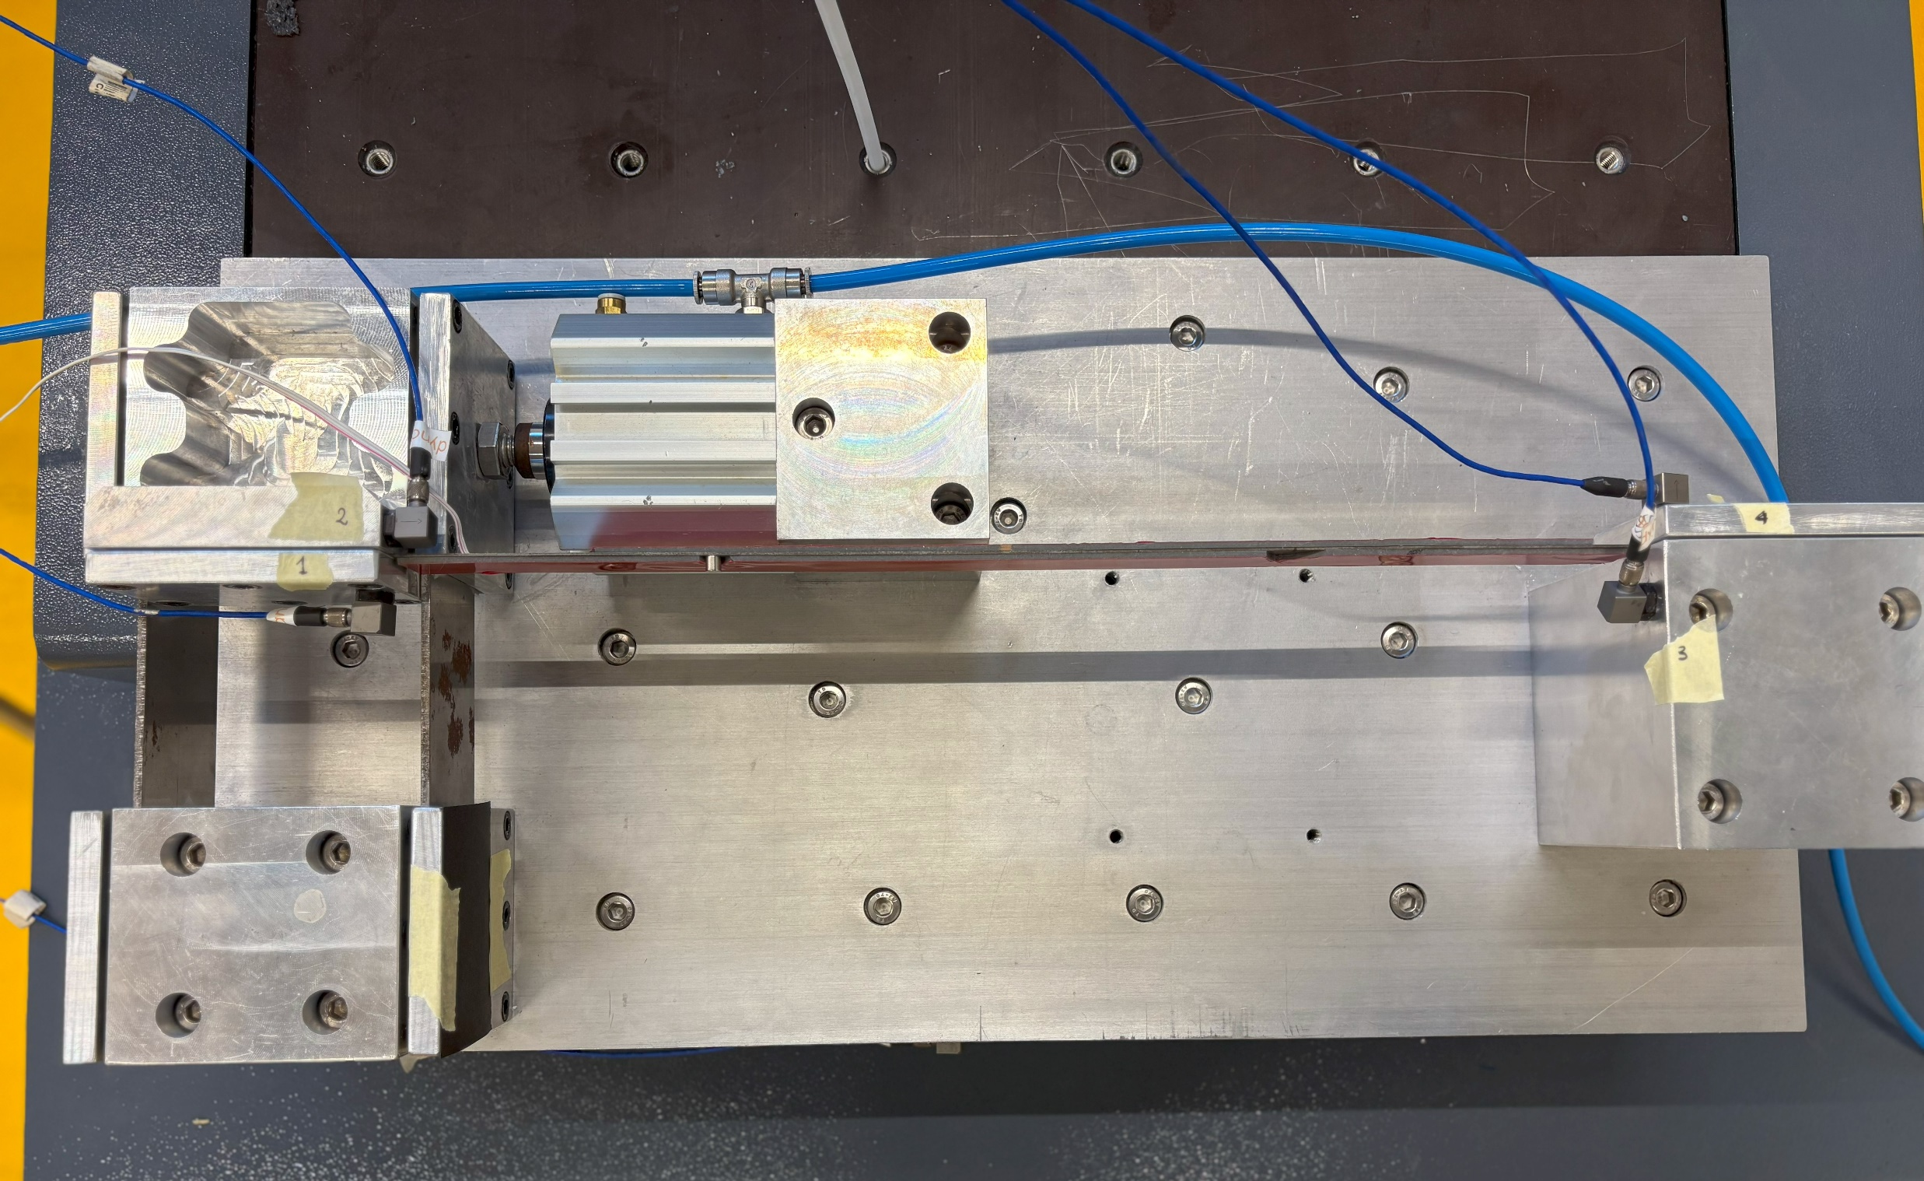
Experimental set up
Notes:
View from above
Viscous-elastic tape

Slide 8
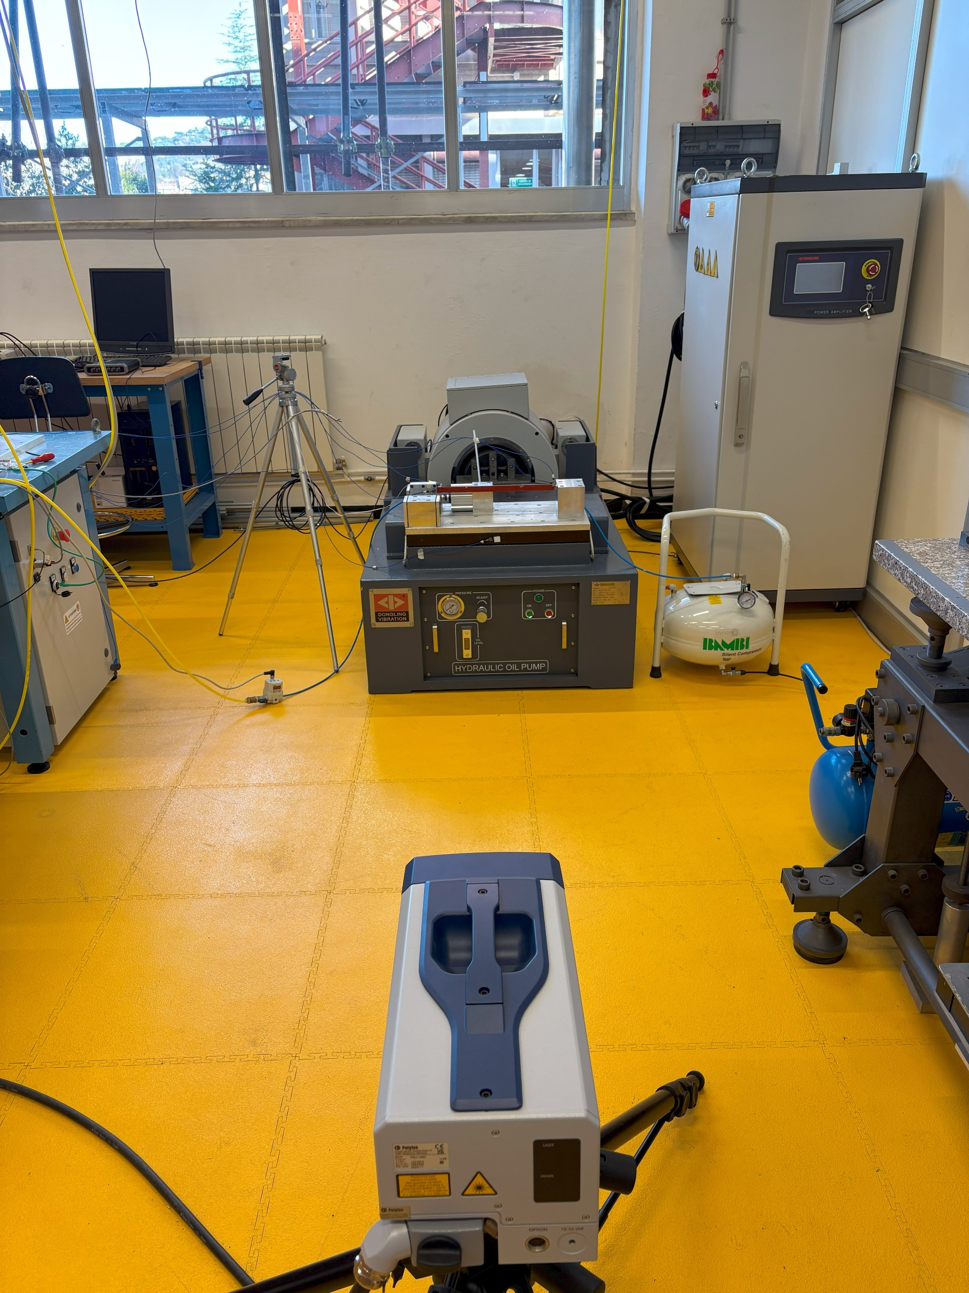
Experimental validation
Acquisition set up
Notes:
Vibrometer lase doppler

Slide 9
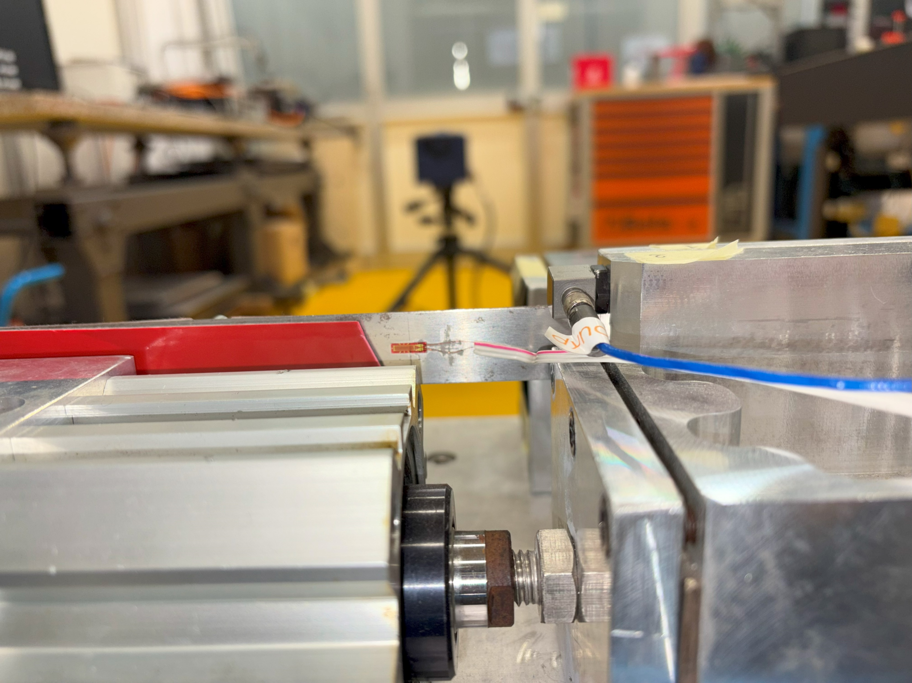
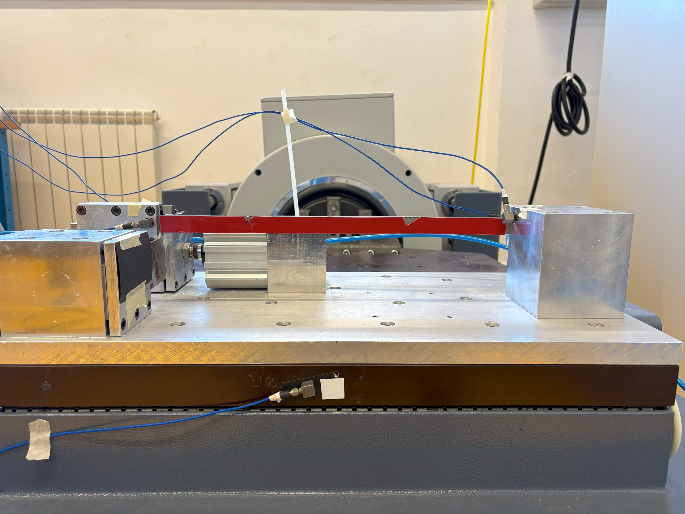
Experimental set up
Acquisition set up

Slide 10
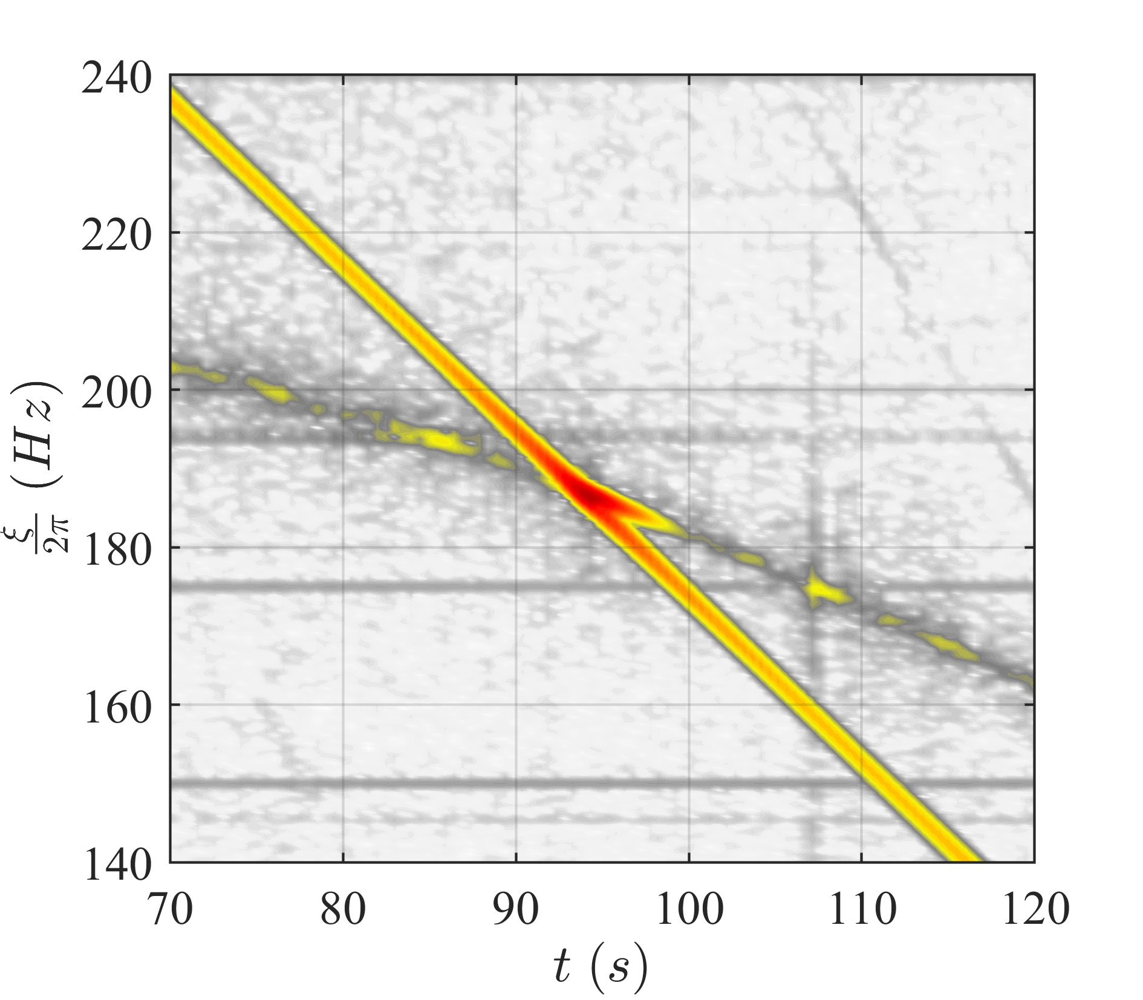
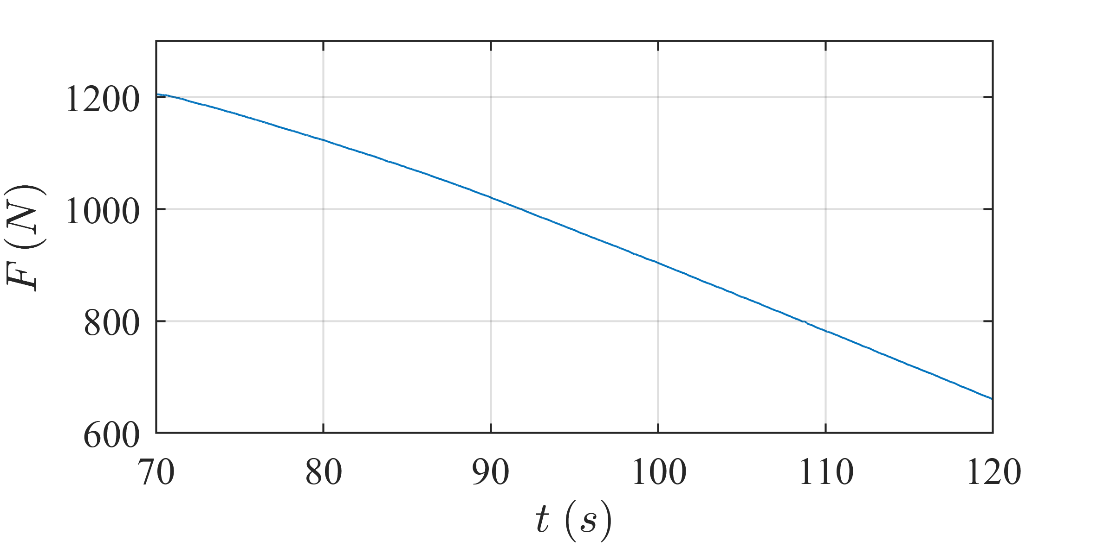
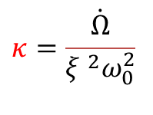
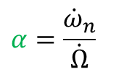
Tests
$$κ=10$$
Natural frequency slope :
$$α=\frac{{\dot{ω}}_{n}}{\dot{Ω}}$$
Sweep rate
$$κ=\frac{\dot{Ω}}{ξ ^{2}ω_{0}^{2}}$$

Slide 11
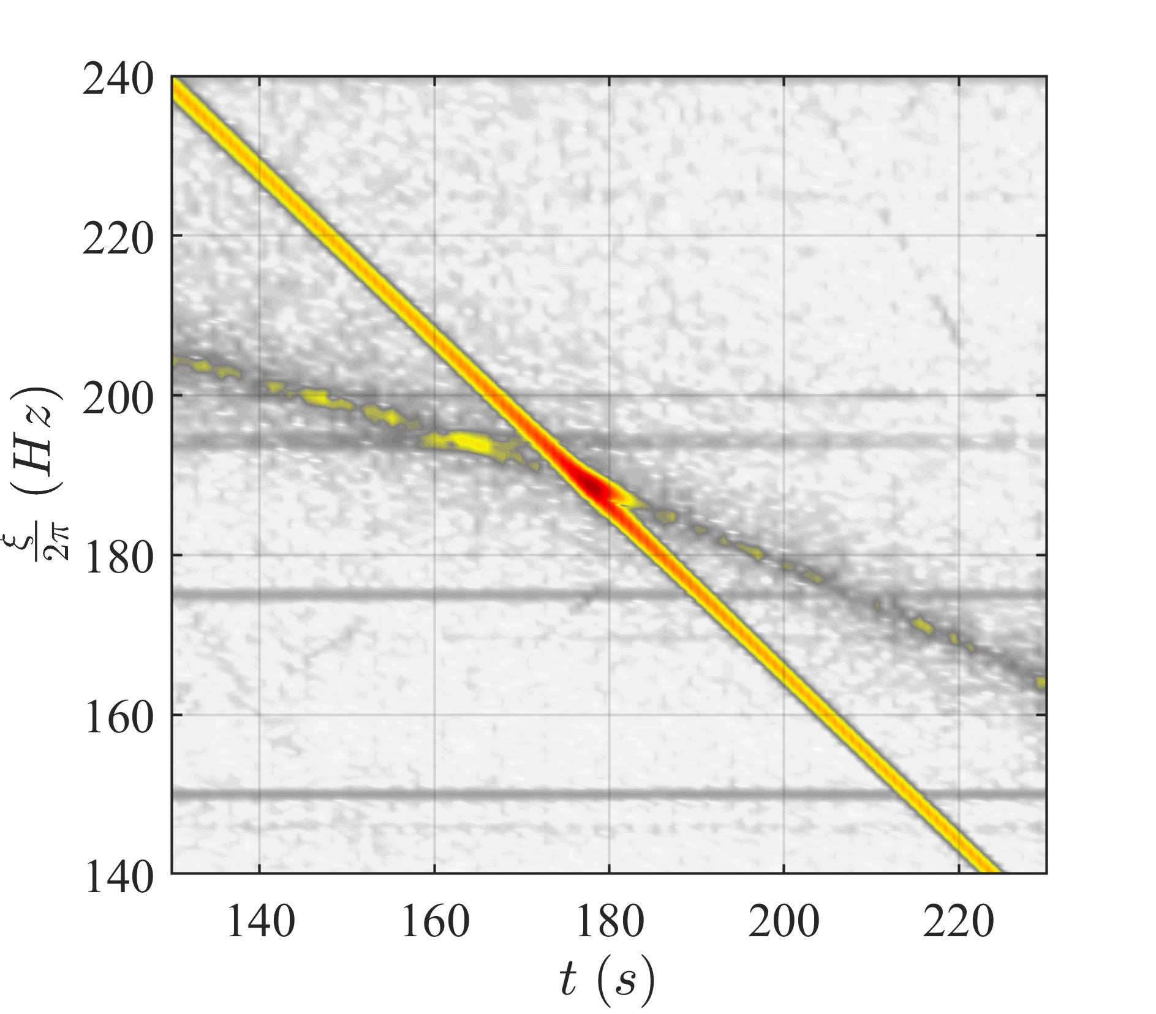
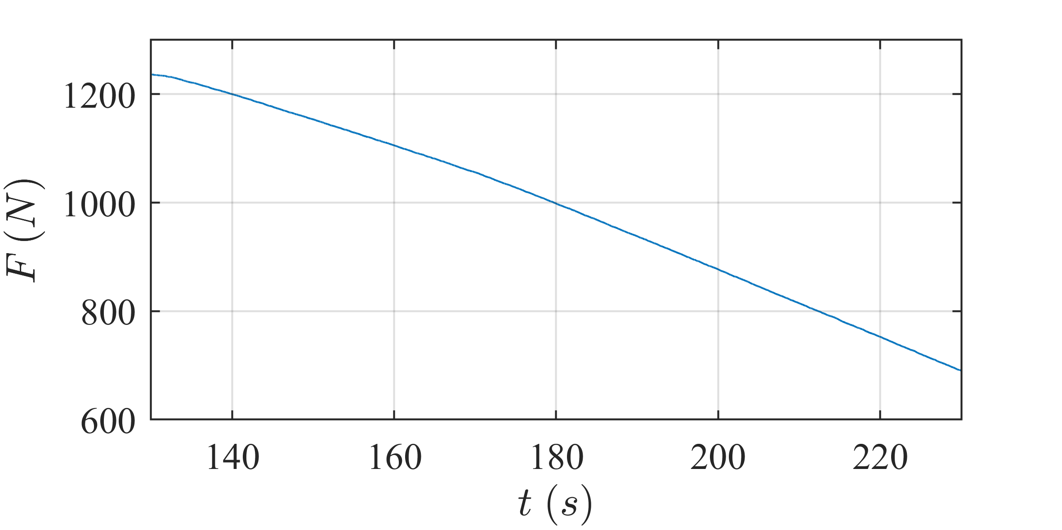
Tests
$$κ=5$$

Slide 12
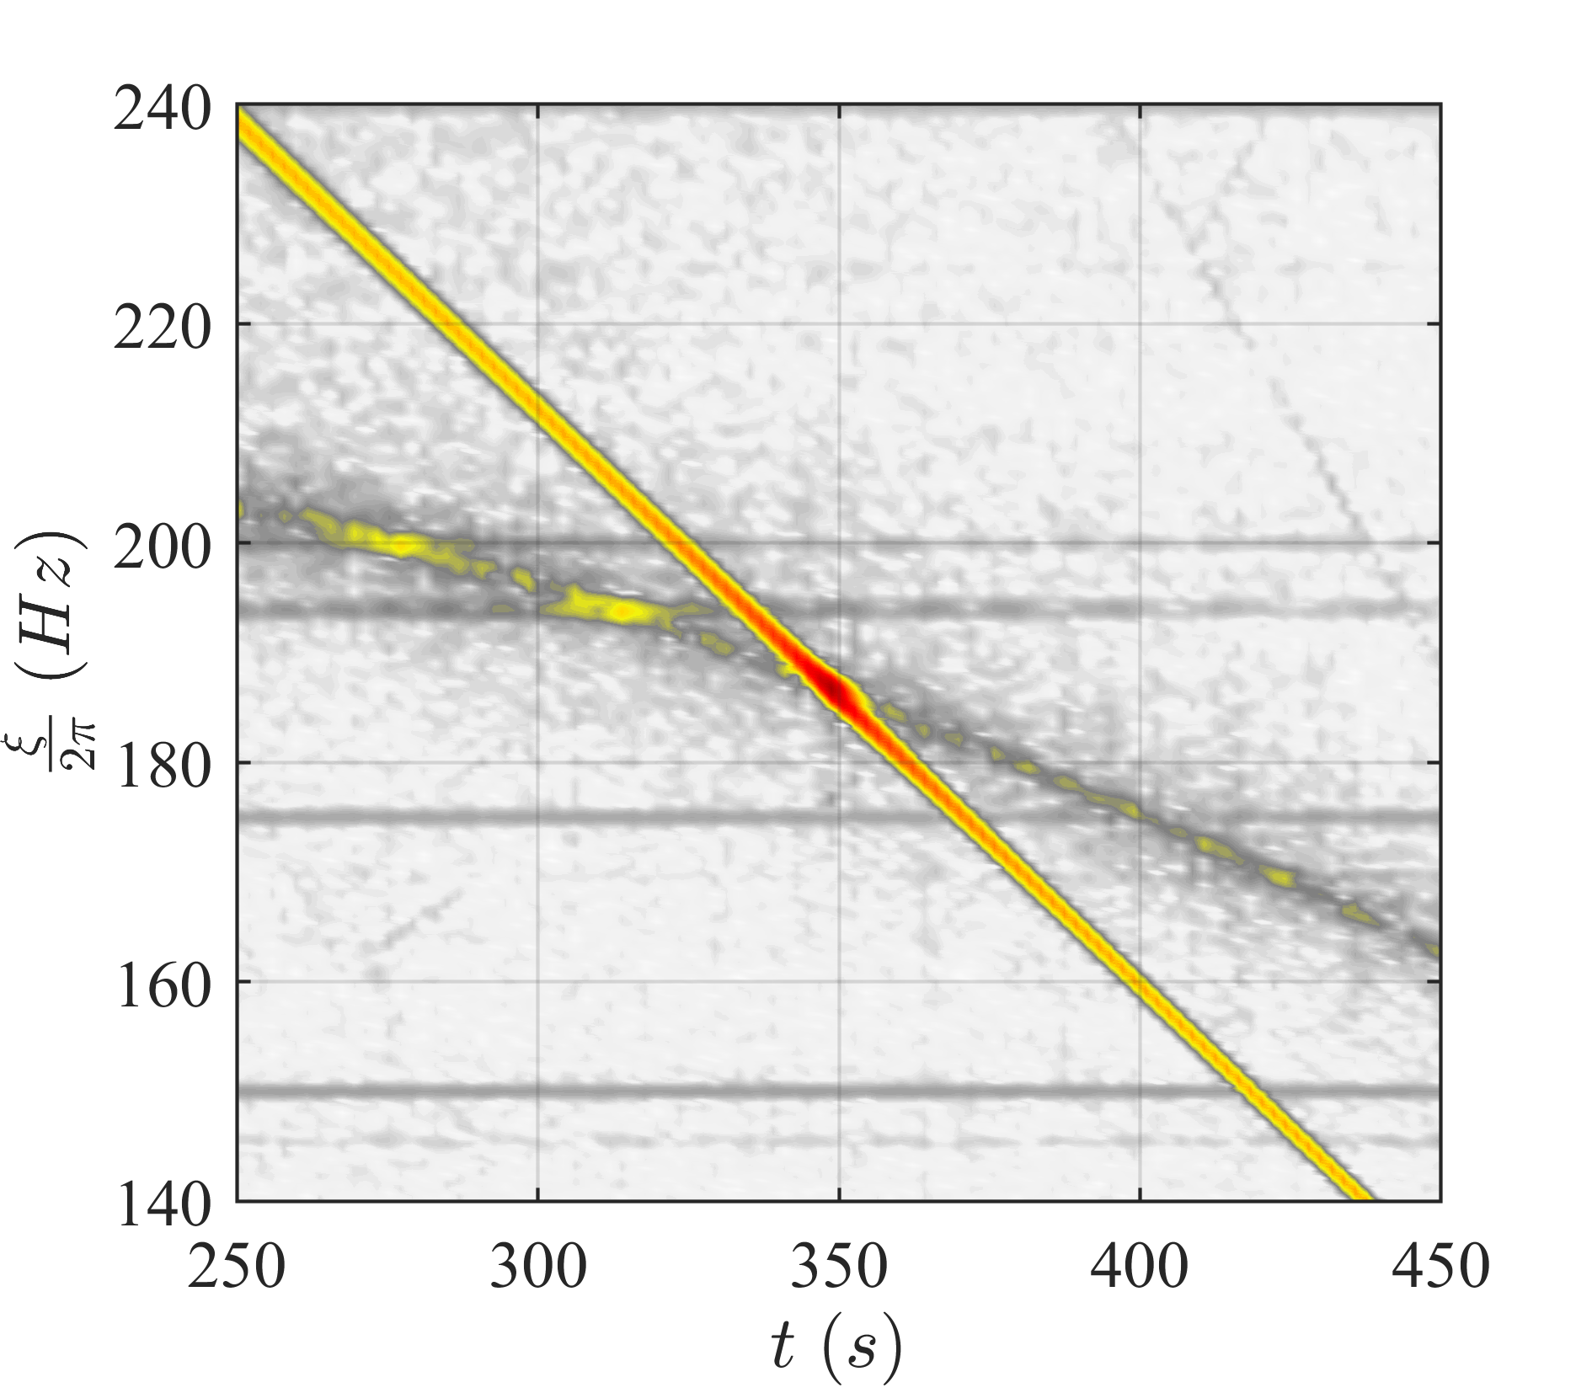
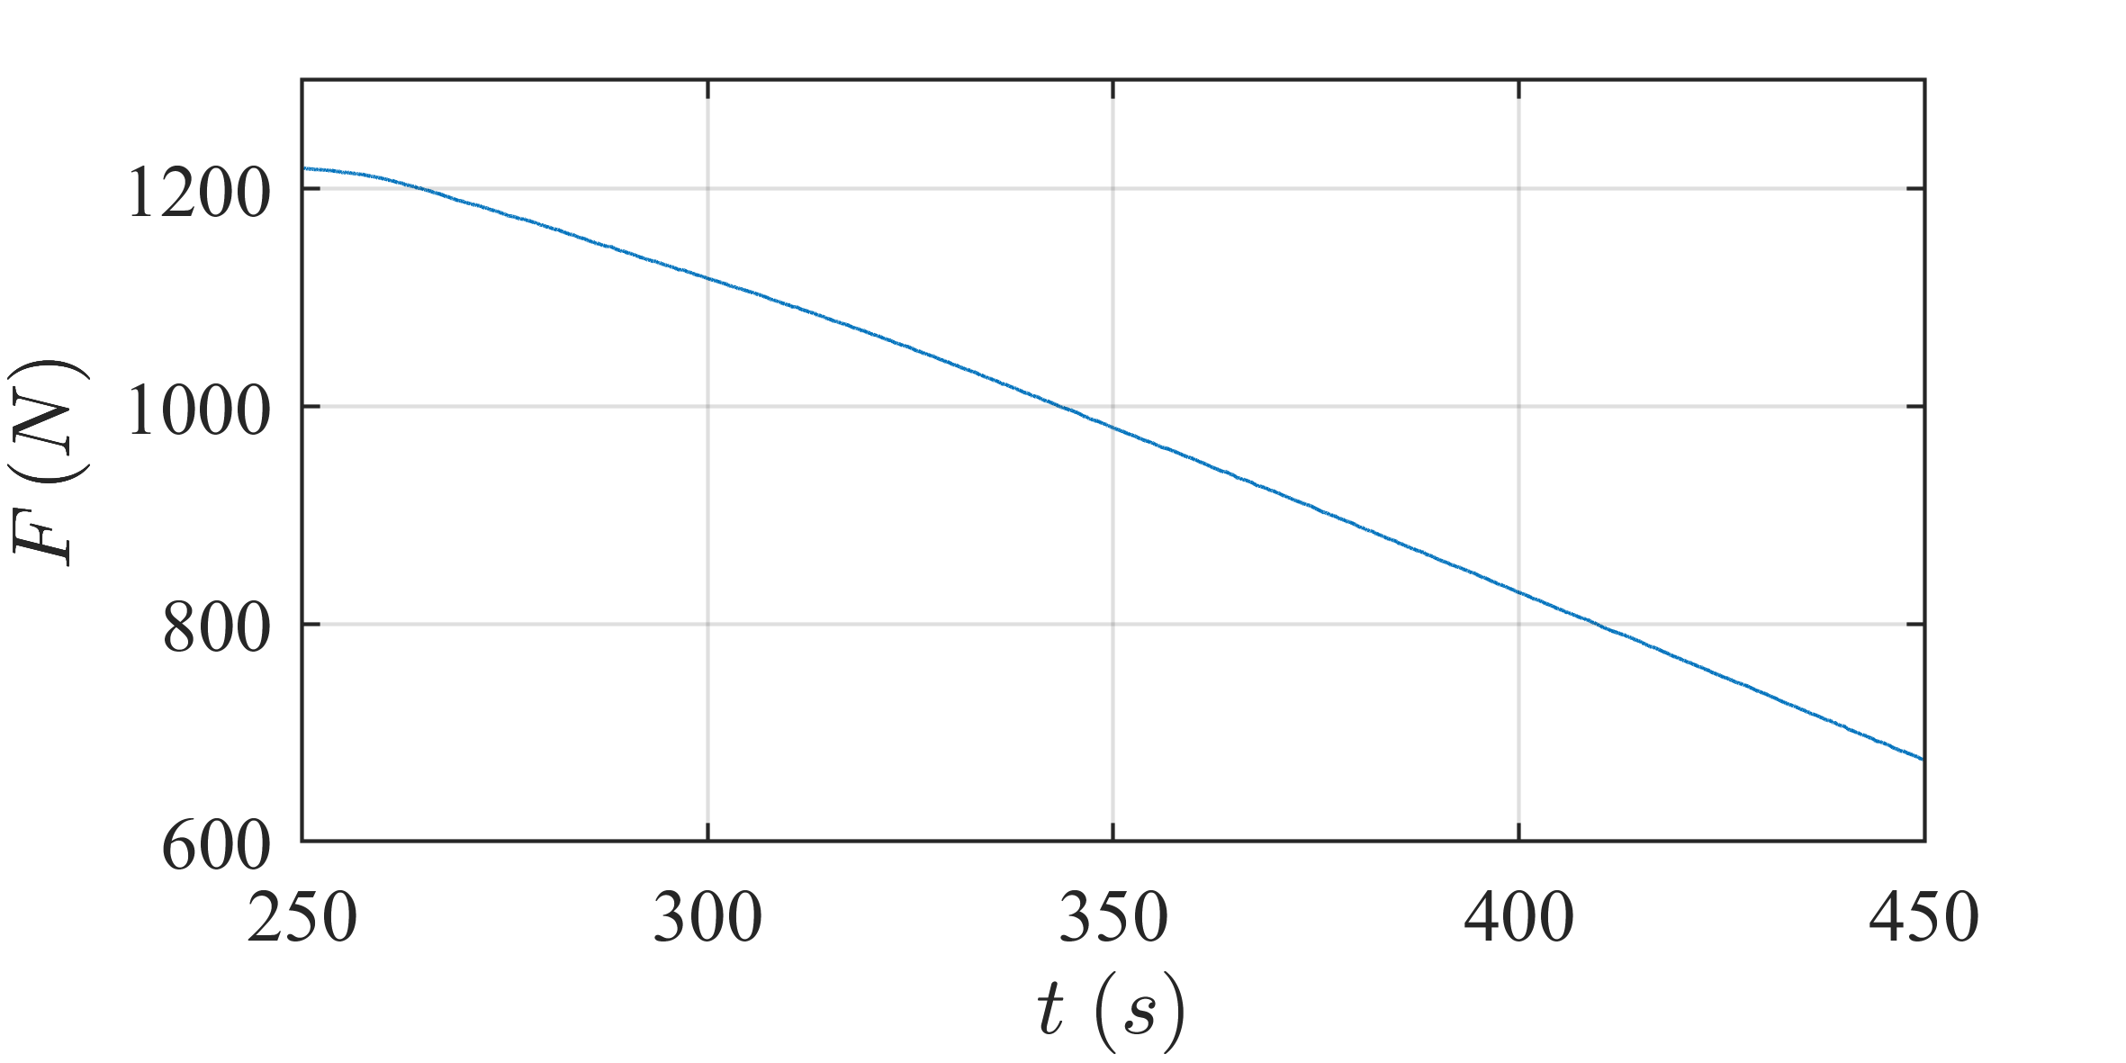
Tests
$$κ=2,5$$

Slide 13
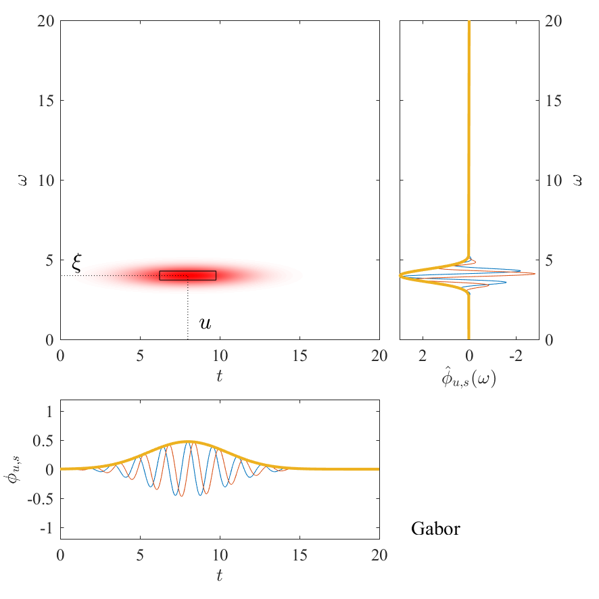
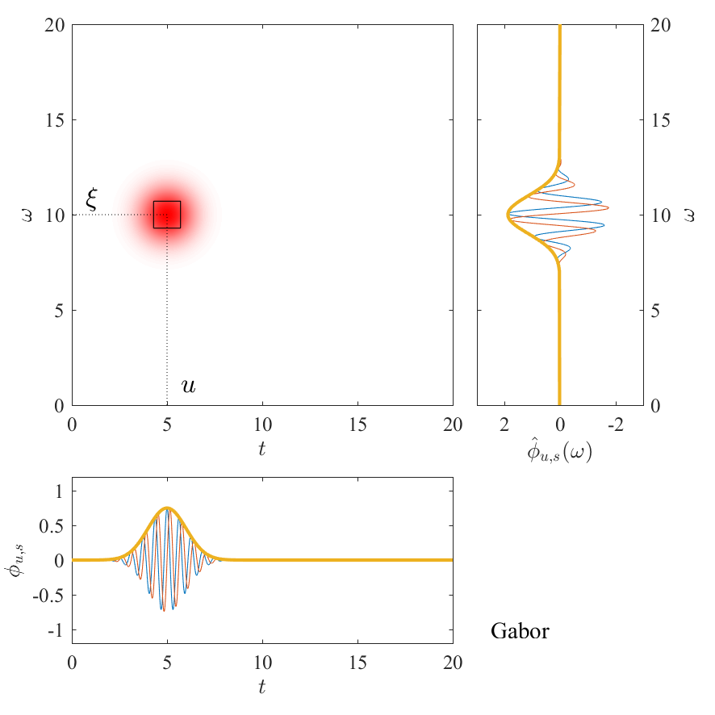
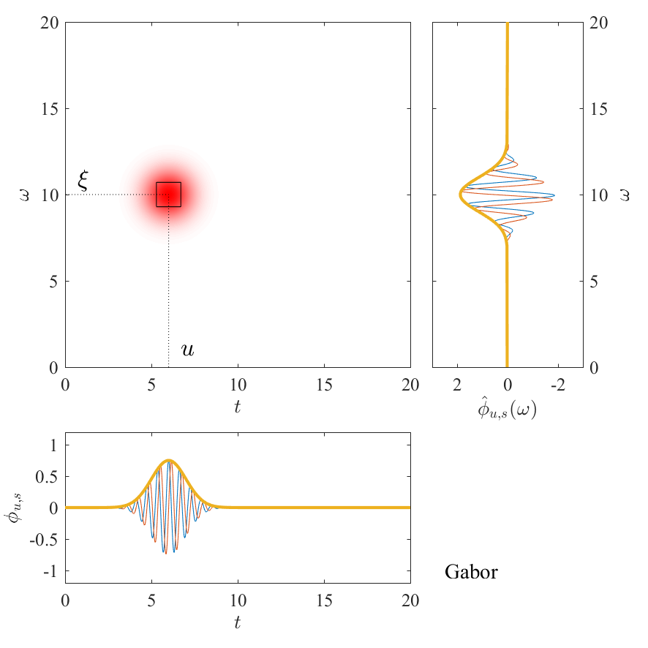
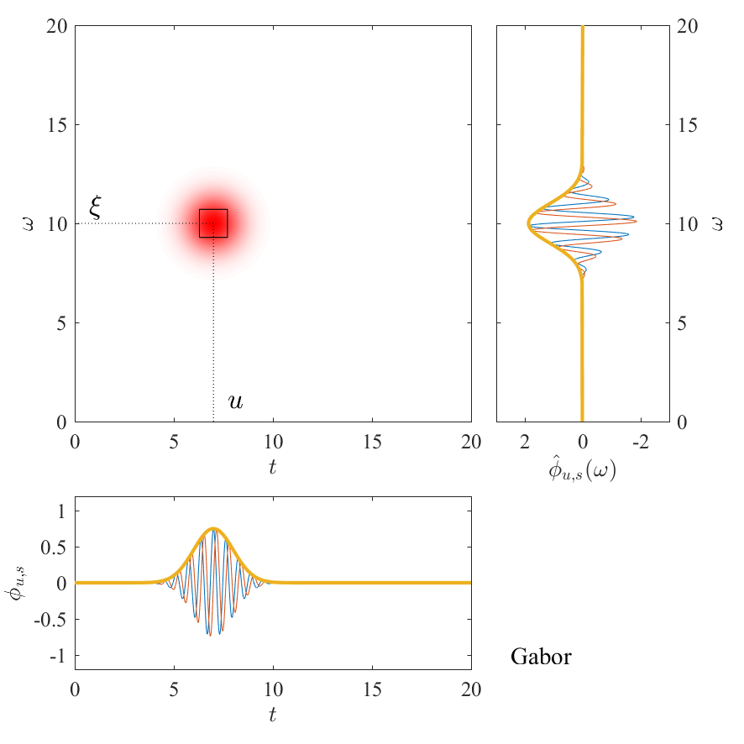
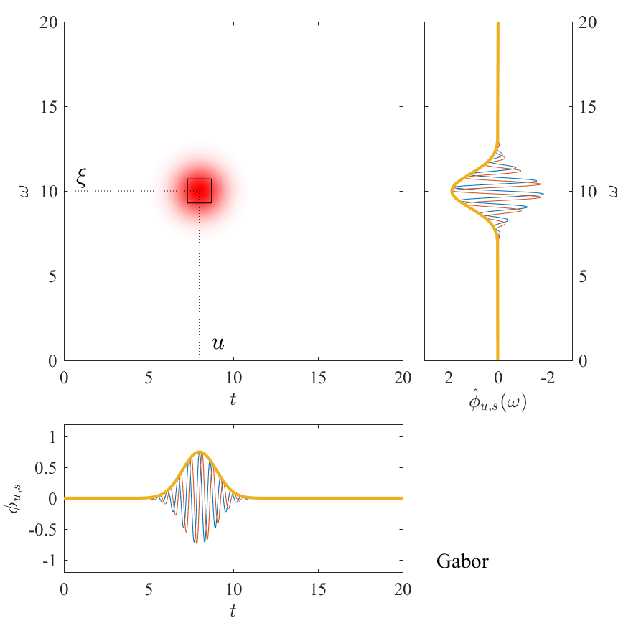
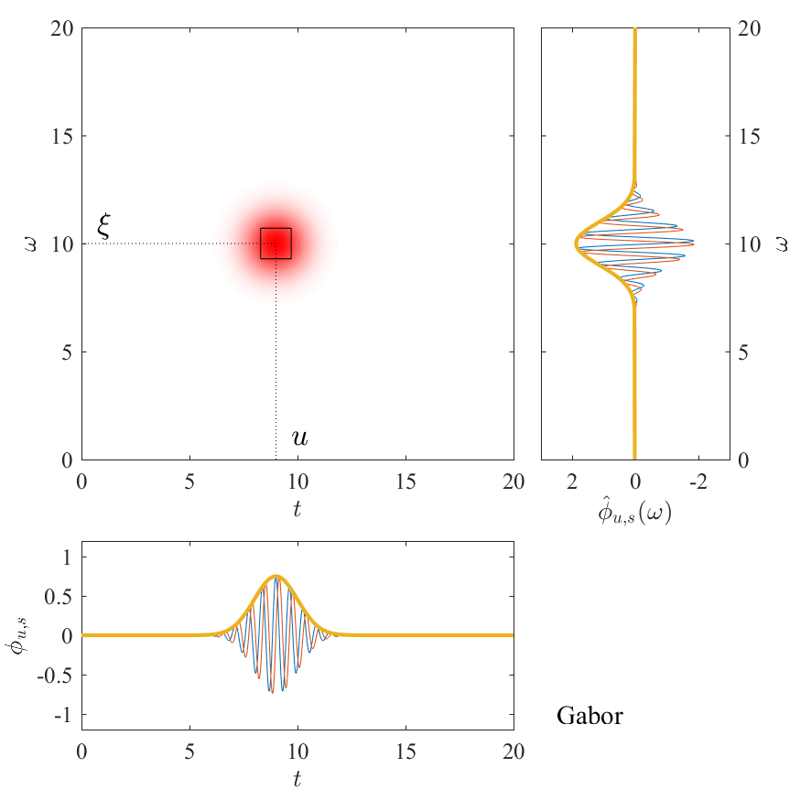
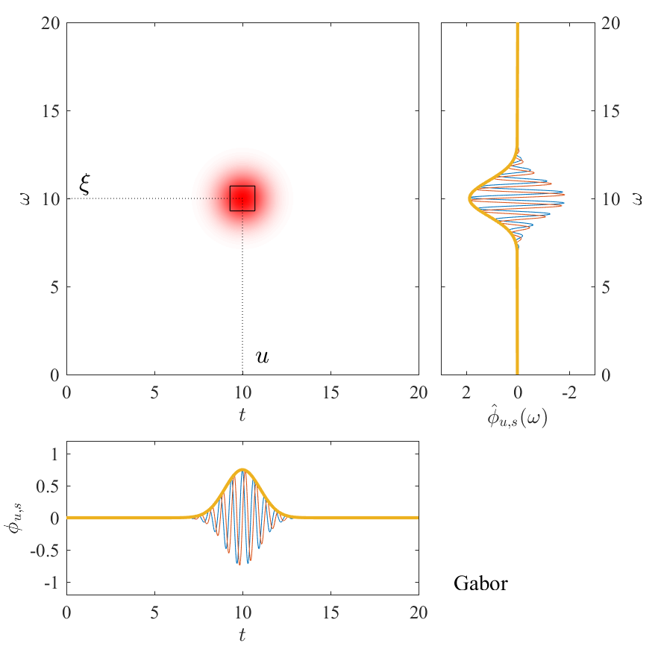
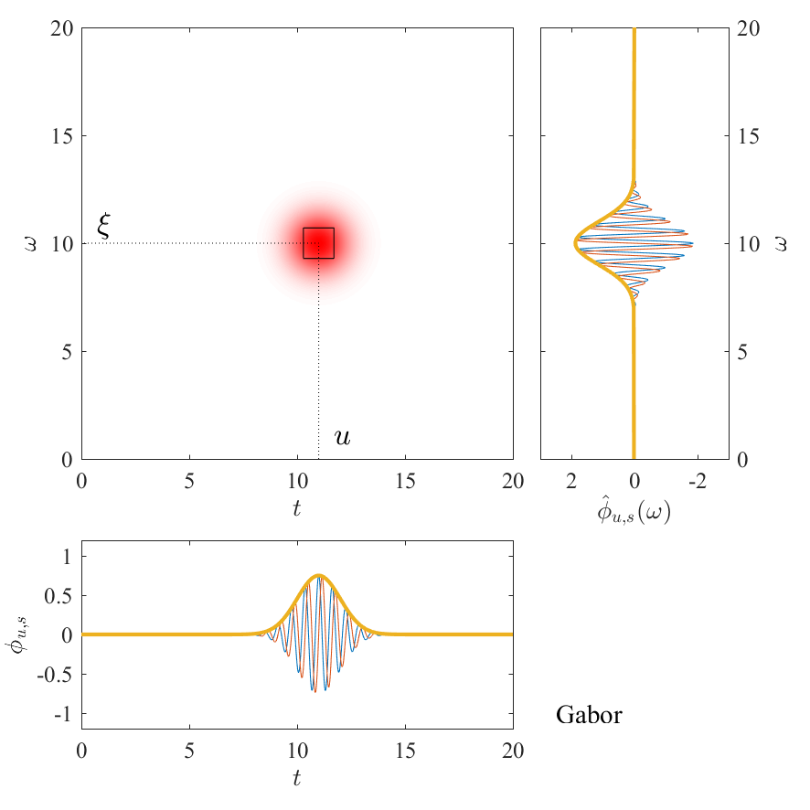
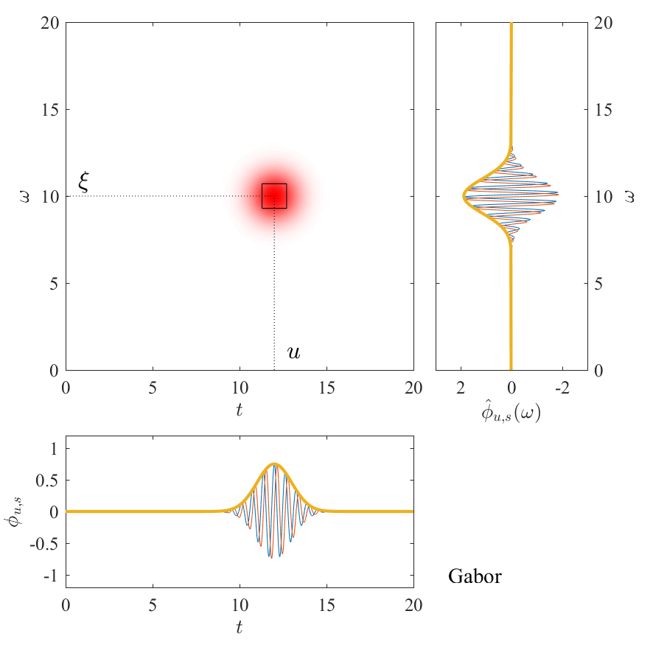
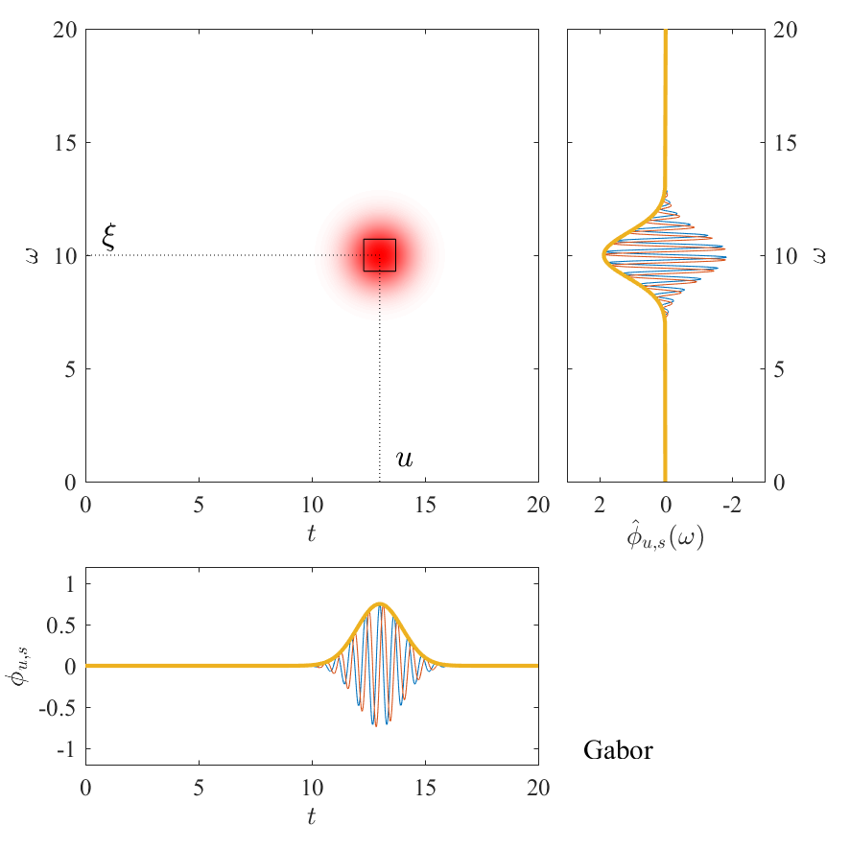
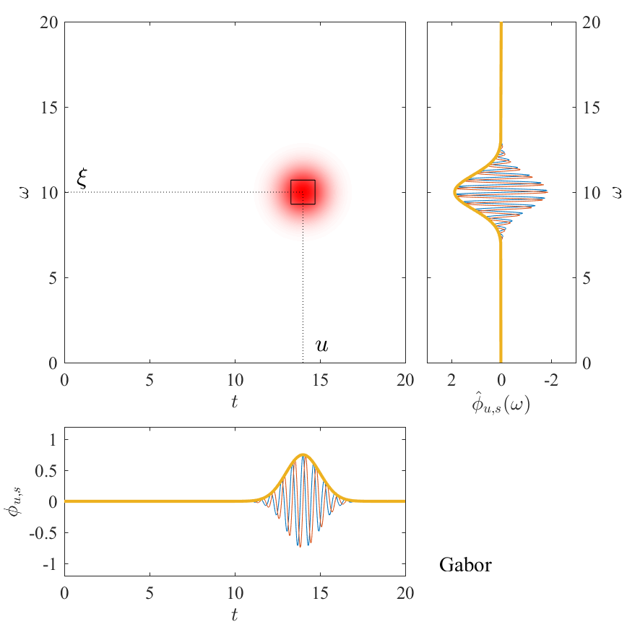
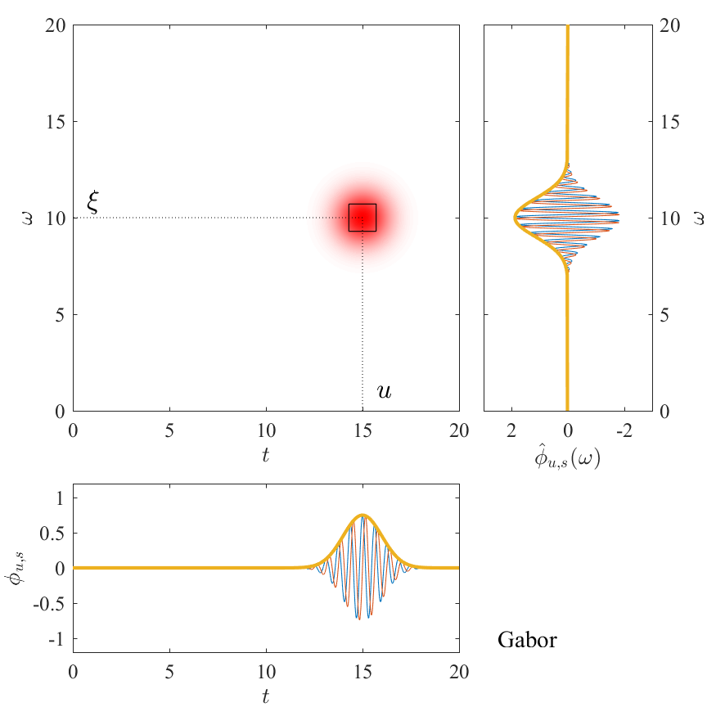
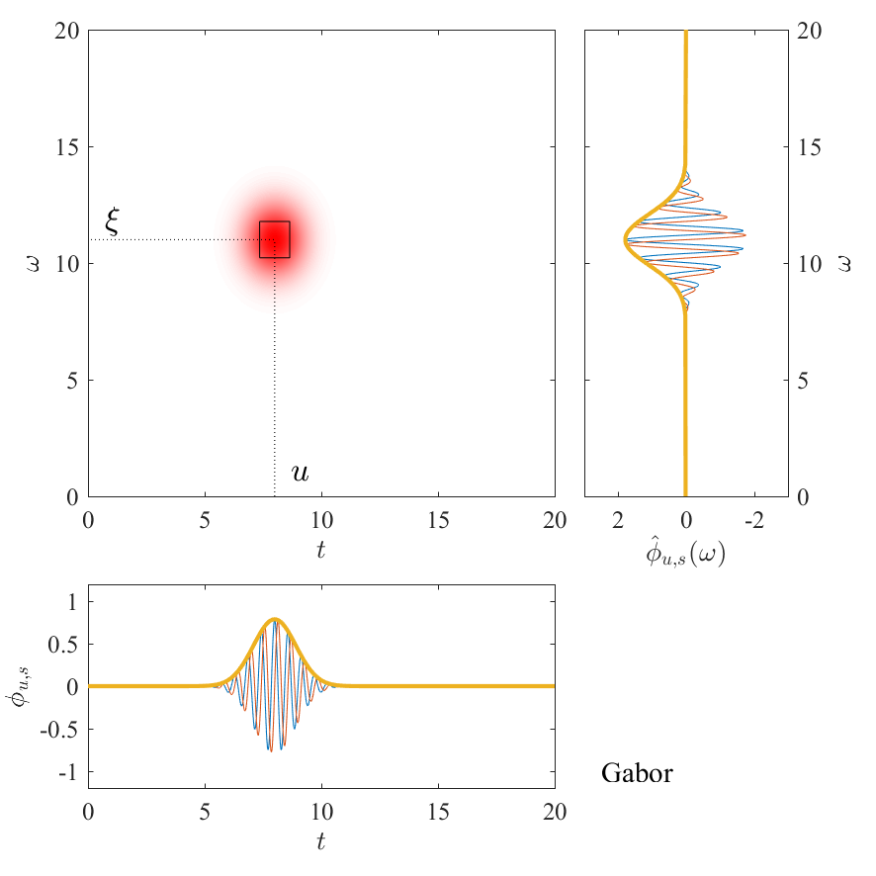
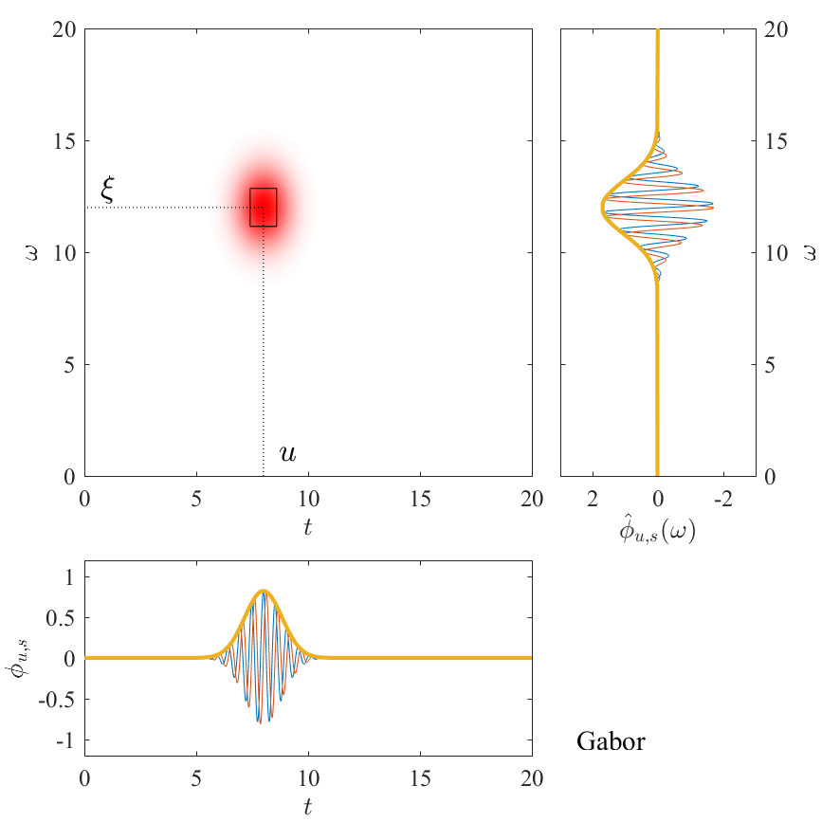
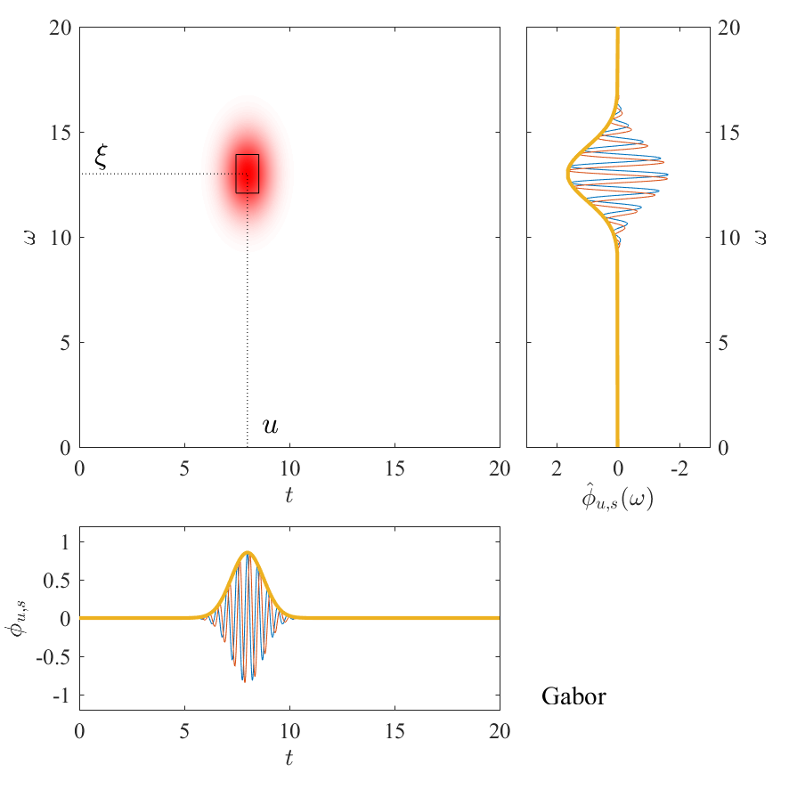
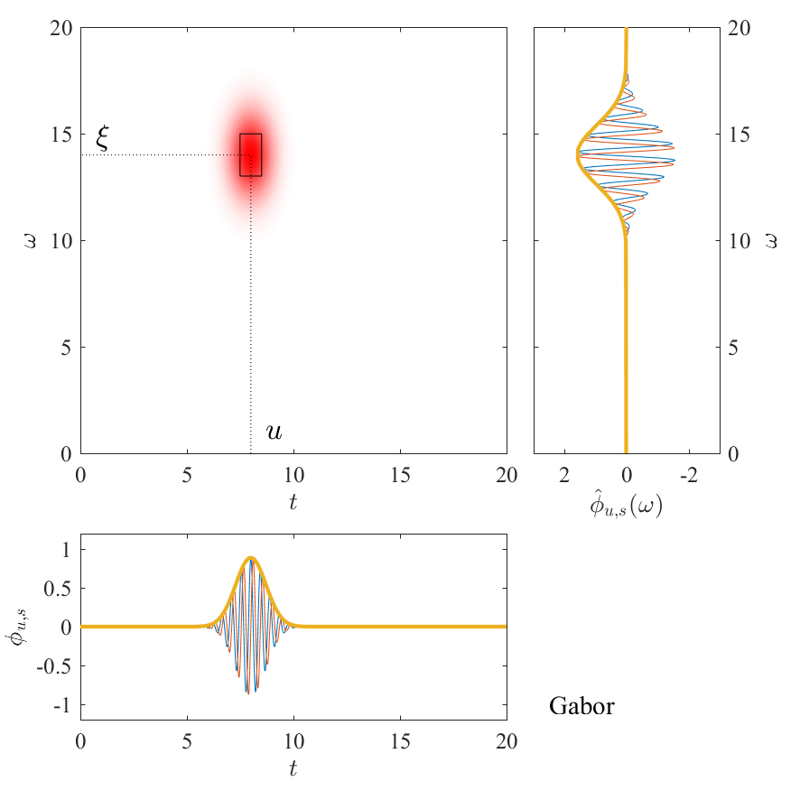
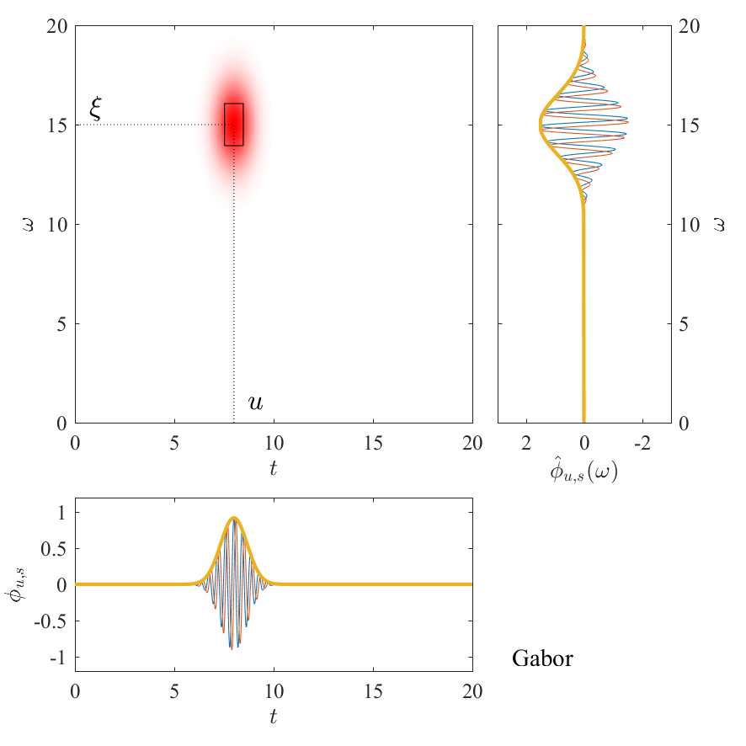
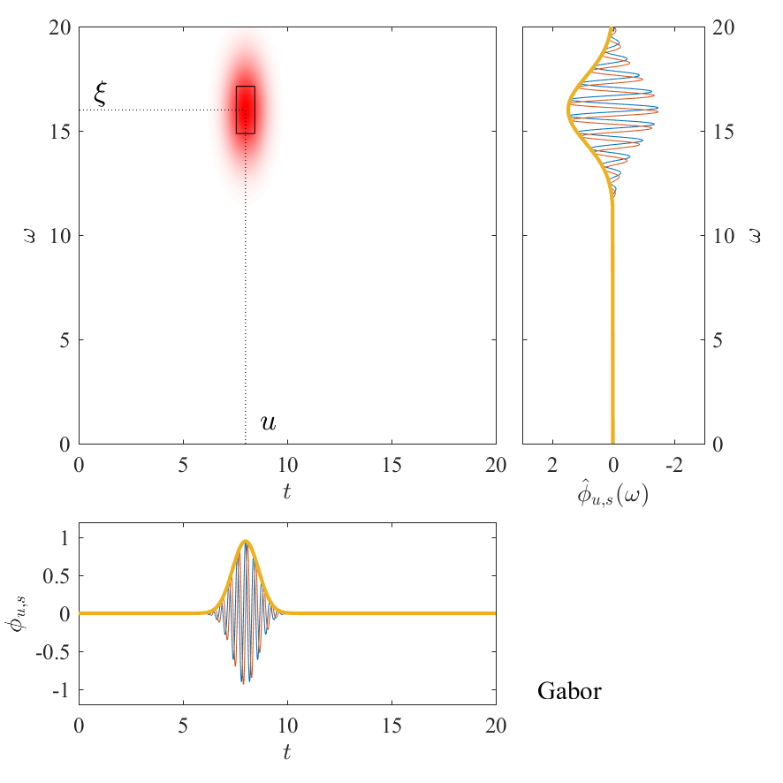
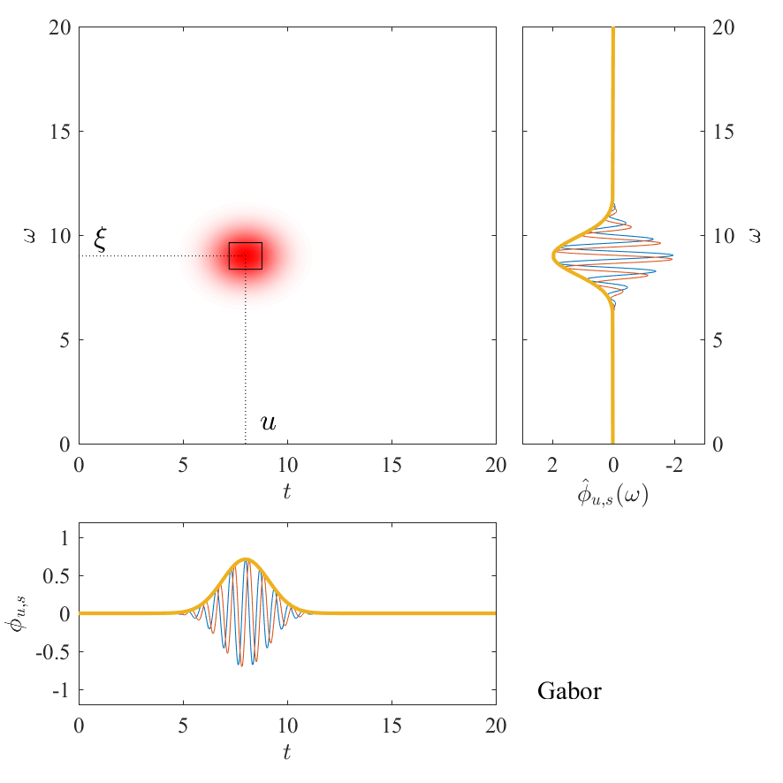
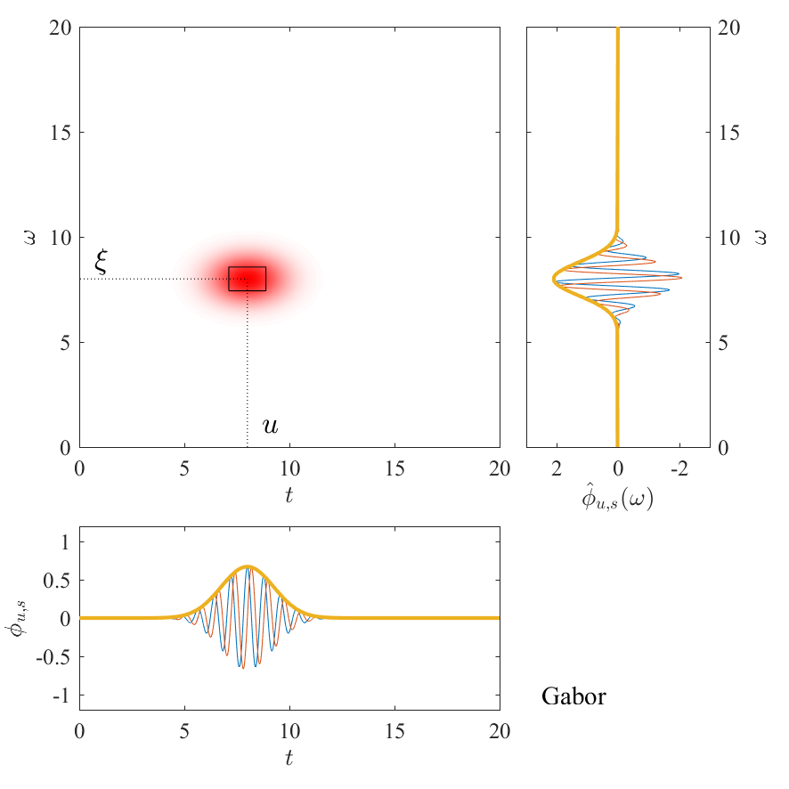
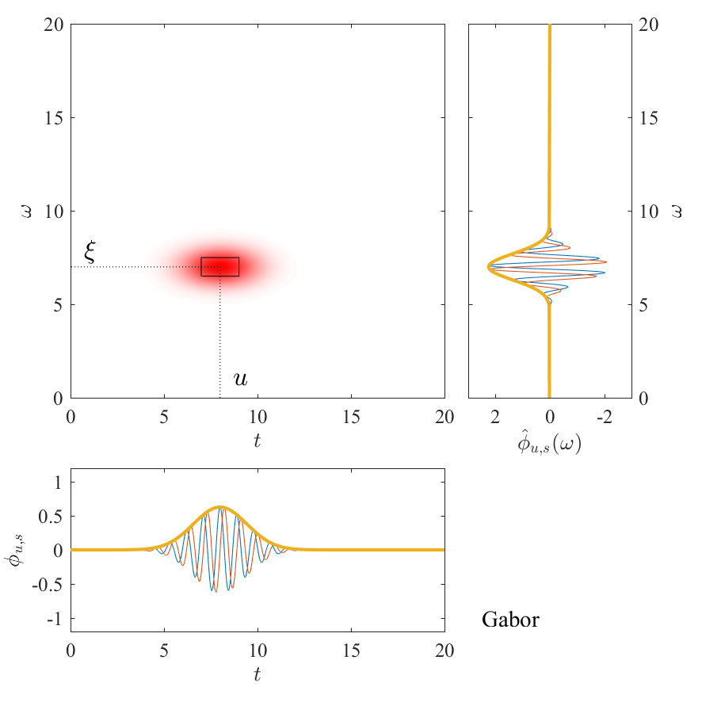
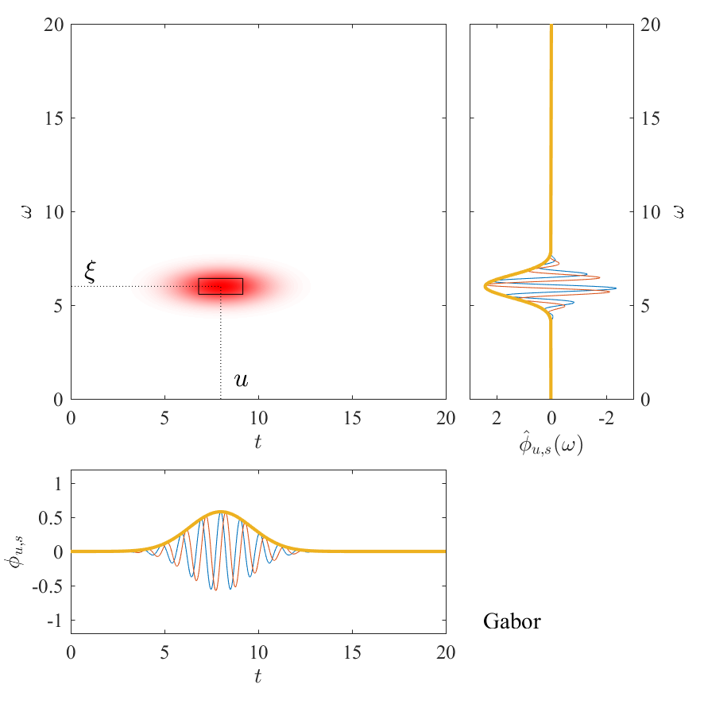
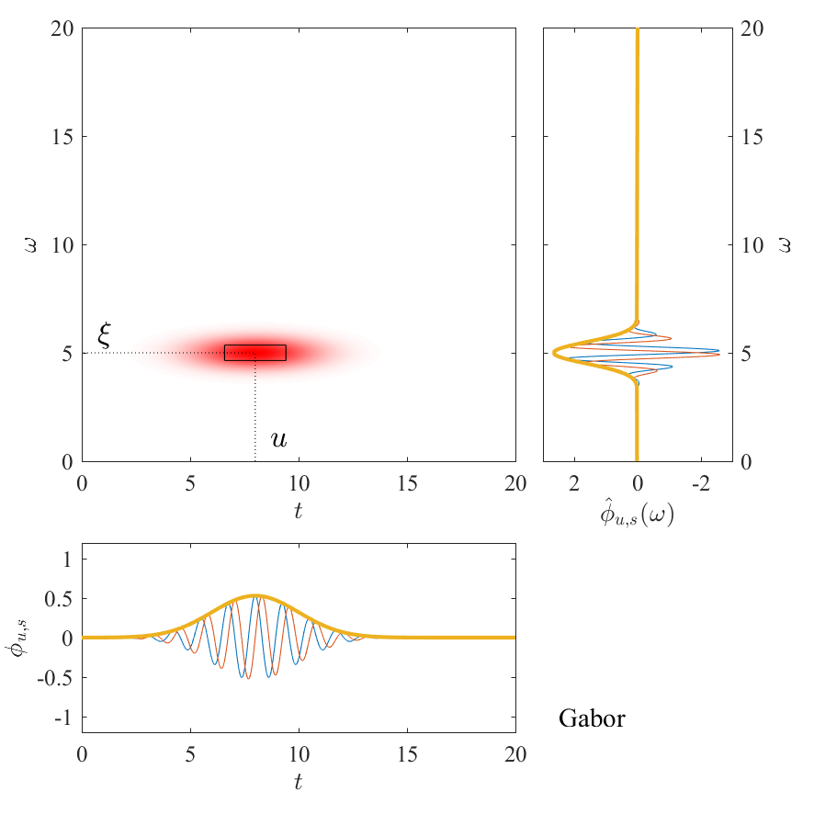
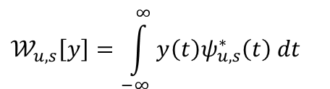
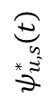
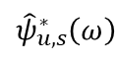
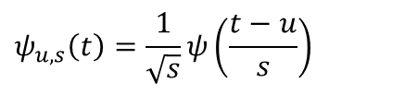
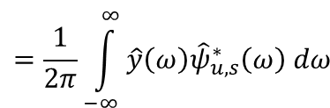
Wavelet Transform
Definition
$$𝒲_{u,s}\left[y\right]=\int_{−∞}^{∞}{y\left(t\right)ψ_{u,s}^{∗}​\left(t\right) dt}$$
$$=\frac{1}{2π}\int_{−∞}^{∞}{\hat{y}\left(ω\right){\hat{ψ}}_{u,s}^{∗}​\left(ω\right) dω}$$
$$ψ_{u,s}\left(t\right)=\frac{1}{\sqrt{s}}ψ\left(\frac{t−u}{s}\right)$$
$${\hat{ψ}}_{u,s}^{∗}​\left(ω\right)$$
$$ψ_{u,s}^{∗}​\left(t\right)​$$
Notes:
correlation between the signal itself and a set of functions called wavelets, parameterized by the central time 𝑢 and the scale 𝑠 . The WT represents the complex amplitude of the signal at
a specific time 𝑢 and for a specific frequency 𝜉. This information, however, is not perfectly localized and may be regarded as an average within a region of the time-frequency plane centered in 𝑢, 𝜉

Slide 14
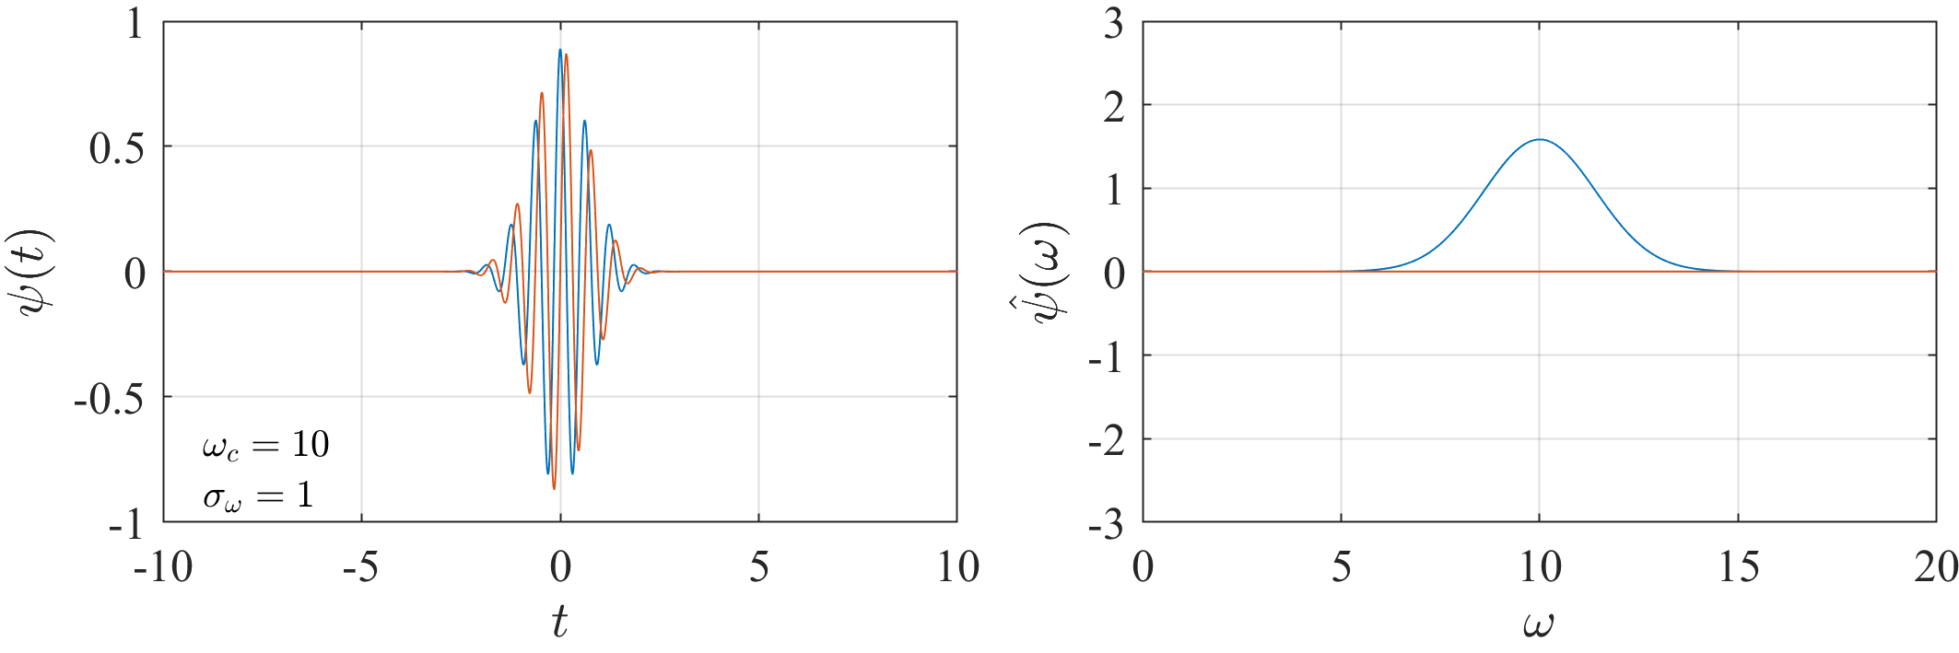
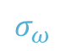
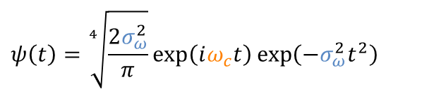

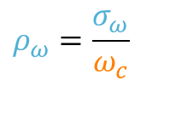




Wavelet Transform
Gabor Wavelet
$$ψ\left(t\right)=\sqrt[4]{\frac{2σ_{ω}^{2}}{π}}\exp\left(iω_{c}t\right)\exp\left(−σ_{ω}^{2}t^{2}\right)$$
$$ψ_{u,s}\left(t\right)=\sqrt[4]{\frac{2ρ_{ω}^{2}ξ^{2}}{π}}\exp\left(i{ξ}t\right)\exp\left(−ρ_{ω}^{2}ξ^{2}{\left(t−u\right)}^{2}\right)\exp\left(−i{ξ}u\right)$$
$${\hat{ψ}}_{u,s}\left(ω\right)=\sqrt[4]{\frac{2π}{ρ_{ω}^{2}ξ^{2}}}\exp\left(−\frac{{\left(ω−ξ\right)}^{2}}{4ρ_{ω}^{2}ξ^{2}}\right)\exp\left(−i{ω}u\right)$$
$$\hat{ψ}\left(ω\right)=\sqrt[4]{\frac{2π}{σ_{ω}^{2}}}\exp\left(−\frac{{\left(ω−ω_{c}\right)}^{2}}{4σ_{ω}^{2}}\right)$$
ω_{c} central frequency
σ_{ω} frequency spread
$σ_{t}=\frac{1}{2σ_{ω}}$ time spread
Relative frequency spread
$$ρ_{ω}=\frac{σ_{ω}}{ω_{c}}$$
$$ω_{c}$$
σ_{t}
$$σ_{ω}$$
Notes:
The lenght of the time interval and the width of the frequency band in which the wavelet and its FT not vanish

Slide 15






















Wavelet transform
Relative frequency spread
$$ψ\left(t\right)=\sqrt[4]{\frac{2σ_{ω}^{2}}{π}}\exp\left(iω_{c}t\right)\exp\left(−σ_{ω}^{2}t^{2}\right)$$
$$ψ_{u,s}\left(t\right)=\sqrt[4]{\frac{2ρ_{ω}^{2}ξ^{2}}{π}}\exp\left(i{ξ}t\right)\exp\left(−ρ_{ω}^{2}ξ^{2}{\left(t−u\right)}^{2}\right)\exp\left(−i{ξ}u\right)$$
$$\hat{ψ}\left(ω\right)=\sqrt[4]{\frac{2π}{σ_{ω}^{2}}}\exp\left(−\frac{{\left(ω−ω_{c}\right)}^{2}}{4σ_{ω}^{2}}\right)$$
$${\hat{ψ}}_{u,s}\left(ω\right)=\sqrt[4]{\frac{2π}{ρ_{ω}^{2}ξ^{2}}}\exp\left(−\frac{{\left(ω−ξ\right)}^{2}}{4ρ_{ω}^{2}ξ^{2}}\right)\exp\left(−i{ω}u\right)$$
$$u$$
$$ξ=\frac{ω_{c}}{s}$$
σ_{t}
$$σ_{ω,s}=\frac{σ_{ω}}{s}$$
$$=ρ_{ω}ξ$$
Relative frequency spread
$$σ_{t,s}=sσ_{t}$$
$$σ_{t,s}=sσ_{t}$$
$$ρ_{ω}=\frac{σ_{ω}}{ω_{c}}$$

Slide 16








Wavelet probing
$$x\left(t\right)$$
Measured response
$$y\left(t\right)$$
Synchronous response
$A\left(t\right)$ $= \left|C(t)𝒲_{u,\frac{ω_{c}}{Ω(t)}}\left[x(t)\right]\right|$
Amplitude estimated by WP
$$C\left(u\right)𝒲_{u,\frac{ω_{c}}{Ω\left(u\right)}}\left[x(t)\right]$$
Synchro response
Full response
Notes:
Wp is a technique to estimate the synchronous response in resonance crossing situation computing the wavelet transfrom along the EO line

Slide 17



Wavelet probing
Dependency of $ρ_{ω}$
$$ρ_{ω}={10}^{−3}$$
$$ρ_{ω}={5∗10}^{−4}$$
$$ρ_{ω}={2∗10}^{−4}$$
Notes:
Good estimation even if the peak is narrow and sharp due to the low value of the damping

Slide 18





Motivation
LTV

Slide 19



Proposed methods for LTV identification
WVD in resonance crossing
The Wigner-Ville distribution for a complex signal $g\left(t\right)$:
$${ 𝒫}_{t,ω}\left[g\left(t\right)\right]= \int_{−∞}^{+∞}{g\left(t+\frac{τ}{2}\right) g^{∗}\left(t−\frac{τ}{2}\right)e^{−iωτ}dτ}$$
For Gabor wavelet :
$ψ^{G}\left(t\right)=\sqrt[4]{\frac{1}{2σ_{t}^{2}π}}\exp\left(−\frac{t^{2}}{4σ_{t}^{2}}\right)exp⁡(iω_{c}t)$
$${ 𝒫}_{t,ω}\left[ψ_{u,s}^{G}\left(t\right)\right]=\frac{1}{π}\exp\left(−\frac{{\left(t−u\right)}^{2}}{2σ_{t,s}^{2}}−\frac{{\left(ω−ξ\right)}^{2}}{2σ_{ω,s}^{2}}\right)$$
Notes:
To analyzed the shape of HB, I need to introduce a mathematical tool call

Slide 20









Proposed methods for LTV identification
Rotated Gabor wavelet
$$𝒫_{t,ω}\left[ ψ_{u,s}^{R}\left(t\right)\right]=\frac{1}{π}\exp\left(\frac{i}{2}𝕩^{T}𝔸^{−1}𝕩\right)$$
$$θ$$
$$𝕩=\left[\begin{matrix}t−u \\ ω−ξ\end{matrix}\right]$$
$$2b$$
$$2a$$
$$𝔸={\left[\begin{matrix}\cos{θ} & \sin{θ} \\ −\sin{θ} & \cos{θ}\end{matrix}\right]}^{T}\left[\begin{matrix}a & 0 \\ 0 & b\end{matrix}\right]\left[\begin{matrix}\cos{θ} & \sin{θ} \\ −\sin{θ} & \cos{θ}\end{matrix}\right]$$
$ψ_{u,s}^{R}\left(t\right)= \sqrt[4]{\frac{2α_{,s}^{2}}{π} }\exp\left(−α_{,s}^{2}{(t−u)}^{2}\right)\exp\left(\frac{i}{2}β_{,s}{(t−u)}^{2}\right)$ $\exp\left(iξ(t−u\right))$
$$θ≪1$$
$$a≫b$$
$$\begin{matrix}α_{,s}=\frac{1}{2a} \\ β_{,s}=tan⁡(θ)\end{matrix}$$
Iaffaldano, D, Guida, R, & Carassale, L.(2024) "Synchronous Response of Rotor Components by Rotated Wavelet Probing." Proceedings of the ASME Turbo Expo 2024. Volume 10B.

Slide 21













$$\dot{Ω}$$
Proposed methods for LTV identification
LTI – LTV equivalence
$${\dot{ω}}_{n}$$
S-DOF model governing equation :
$$ω_{0}$$
$$\ddot{q}+2ξω_{n}​\left(t\right)\dot{q}+ω_{n}^{2}​\left(t\right)q=\frac{p_{0}}{m}e^{\frac{i}{2}r\dot{Ω}t^{2}}$$
$$t^{′}=t−t_{0}$$
Dimensionless time and dimensionless response :
$$t_{0}$$
$$τ=ω_{0}t^{′}$$
$$x=\frac{p_{0}}{2​​ξ​​i​​m​​ω_{0}^{2}}q$$
Small dimensionless parameter
NF slope
Sweep rate
$$=ε$$
$$α=\frac{{\dot{ω}}_{n}}{\dot{Ω}}$$
$$κ=\frac{\dot{Ω}}{ξ ^{2}ω_{0}^{2}}$$
$$ξ$$

Slide 22








Proposed methods for LTV identification
Multiple time-scale solution
$x^{′′}+2ε\left(1+ακε^{2}τ\right)x^{′}+{\left(1+ακε^{2}τ\right)}^{2}x=2$ $ε{ie}^{iτ}e^{\frac{i}{2}κε^{2}τ^{2}}$
Fast time : $τ$
Slow time :
$$T=ετ$$
Leading order solution :
$$x_{0}=A\left(T\right)e^{iτ}$$
( slowly modulated harmonic response )
$$A^{′}\left(T\right)+\left(1−iαT\right)A\left(T\right)=e^{\frac{i}{2}κT^{2}}$$
Secularity condition :
(linear time varying 1st order ODE)
LTI $(α=0)$
LTV $(α≠0)$
$$A\left(T\right)=e^{−T}𝒟\left(T;κ\right)$$
$𝒟\left(T;κ\right)=\sqrt{\frac{iπ}{2κ} }e^{\frac{i}{2κ} }\operatorname{erfc}\left[e^{\frac{iπ}{4}}\frac{i−κT}{\sqrt{2κ}}\right]$
$$A\left(T\right)=e^{−T}e^{\frac{i}{2}καT^{2}}𝒟\left(T;κ(1−α)\right)$$
Carassale, L., Denoël, V. (2023). “A time-variant/invariant equivalence for transient response of rotor blades in resonance.” IMAC-XLI.
Notes:
Approximated analytic solution

Slide 23









LTV system identification
LTI – LTV equivalence
$$\dot{Ω}$$
$${\dot{Ω}}_{c}$$
Force model
$$p\left(t\right)=\cos\left(ω_{0}t+\frac{1}{2}\left(1−α\right)\dot{Ω}{\left(t−t_{0}\right)}^{2}\right)$$
$$α=\frac{{\dot{ω}}_{n}}{\dot{Ω}}$$

Slide 24


Results
Modal identification
LTV w/ correction
*
LTV with rotated wavelet probing
LTV with correction
Target

Slide 25
Conclusions
Time-Frequency approach. LTV system is analyzed with a rotated Gabor wavelet thought the wavelet probing technique.
Equivalence approach. LTV system is considered as LTI with corrected sweep rate.
Experimental set up for recreate the real operational situation.
Modal identification of LTV system in resonance crossing with force modeling.

Slide 26
Thank you for the attention
Davide Iaffaldano, Luigi Carassale
Dynamics & Monitoring Lab, University of Genova
Roberto Guida
Ansaldo Energia, Genova

